Slide 1
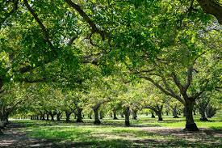

Annual Growers Meeting
August 2025
Linden Lions Club

Slide 2
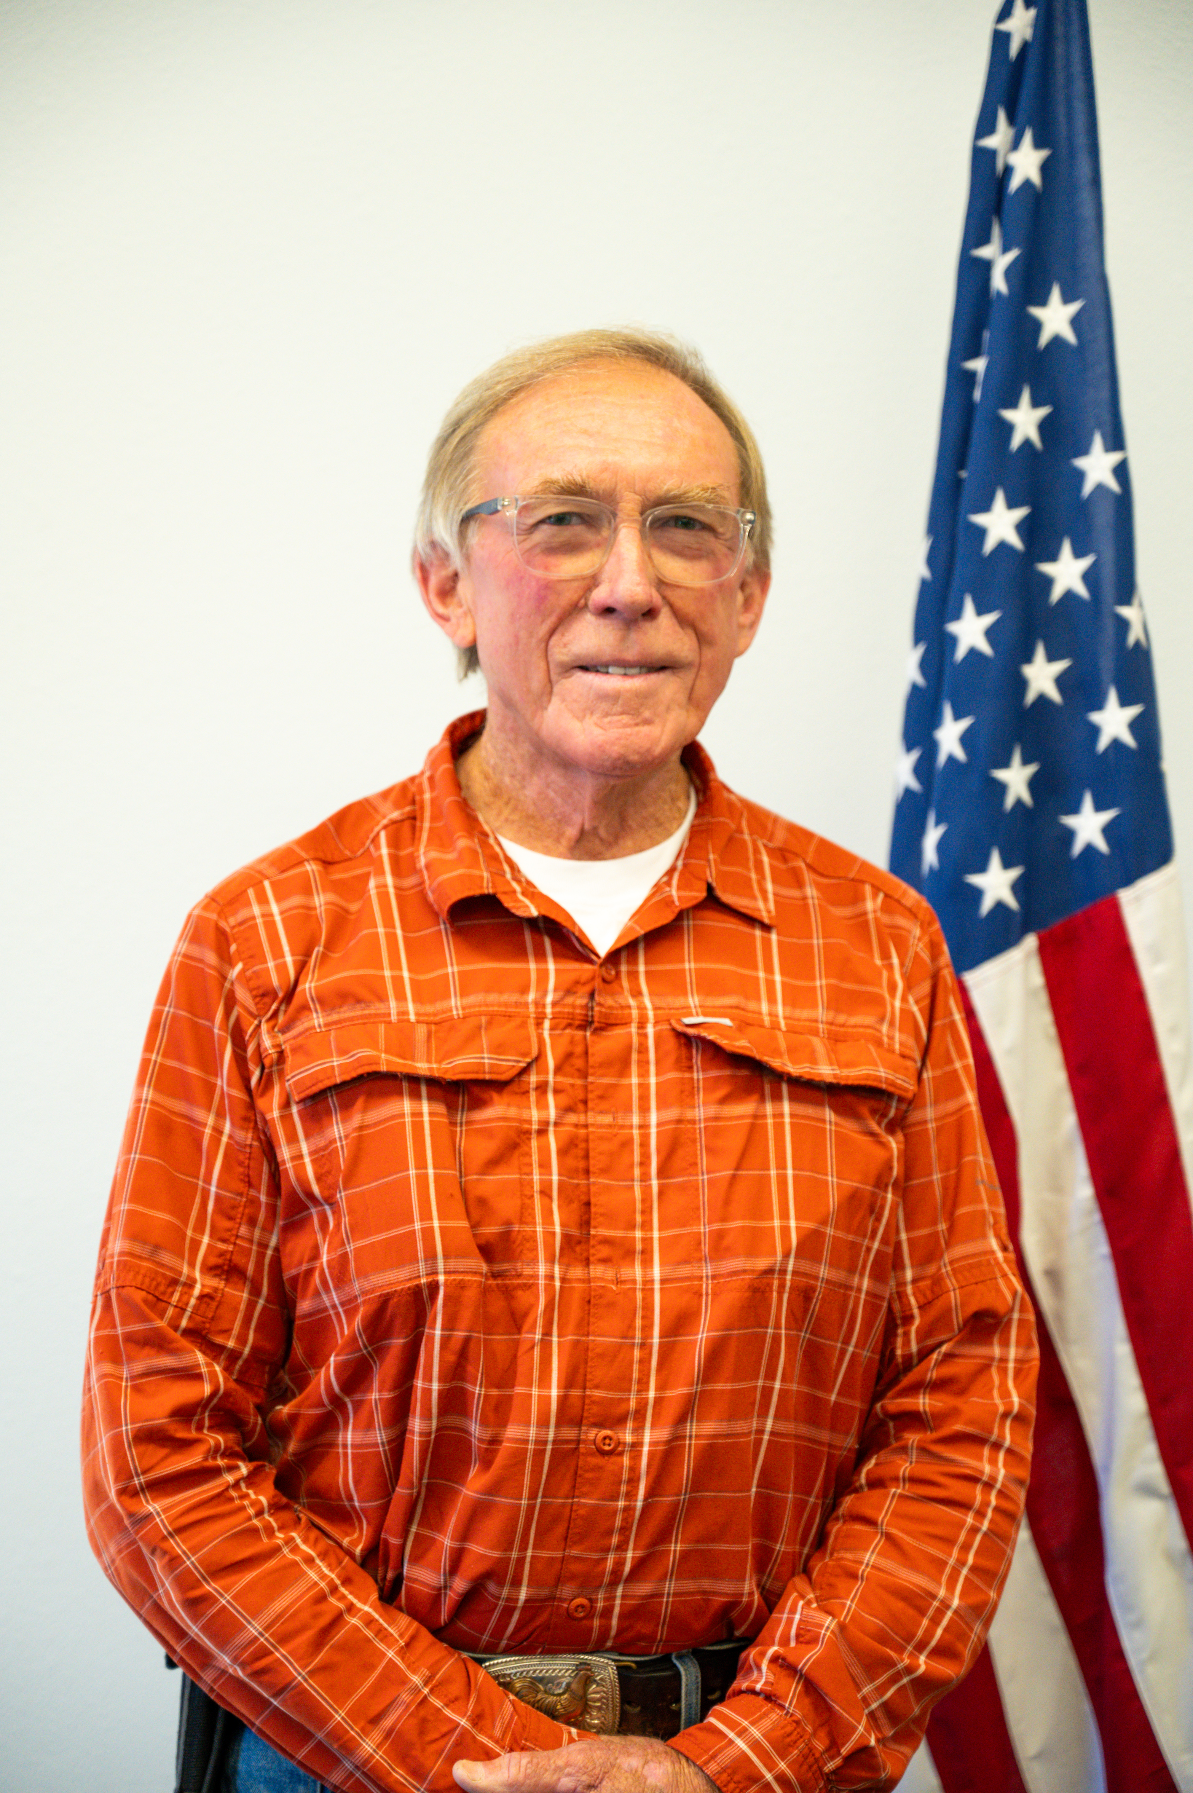
.
Welcoming Remarks
Tom McGurk, President
Board of Directors
Stockton East Water District

Slide 3
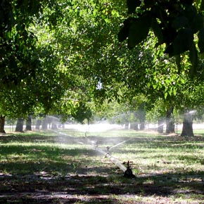
Meeting Agenda
Meet the District
  About Us
District Challenges
  California Sustainable Groundwater Management Act (SGMA)
  Endangered Species Act
  Bay Delta Plan
  Future Weather Conditions
District Solutions and Priorities
  District Plans
  Phytophthora Presentation
  District's Current Projects
  SWEEP Funding Summary
  New Funding Opportunity
Notes:
Juan

Slide 4
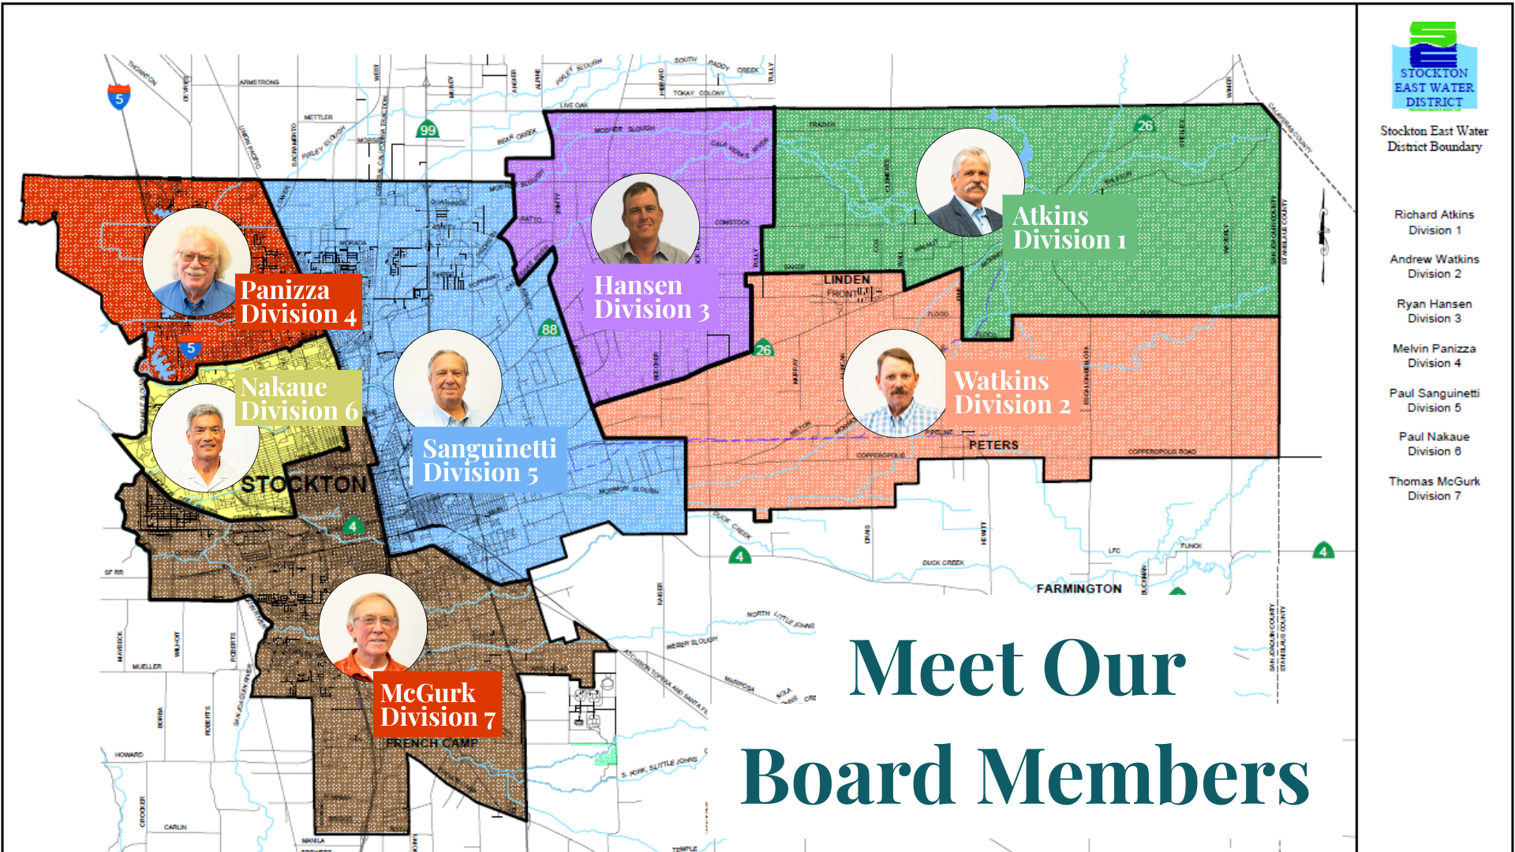
Notes:
Juan

Slide 5

Our Mission
Our mission is to ensure sustainable groundwater, high-quality drinking water, and supplemental surface water for agricultural use.
Notes:
Juan

Slide 6
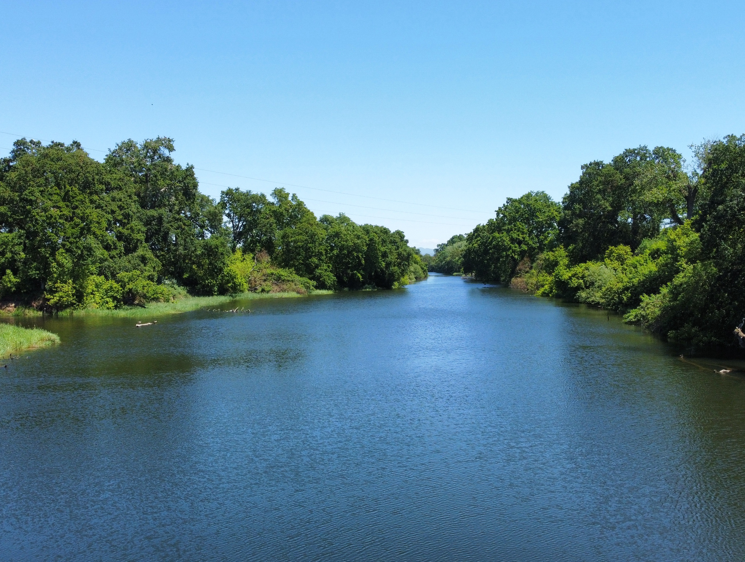
Our Vision
To be a regional leader and reliable partner by implementing innovative solutions for our agricultural and urban customers, securing existing and additional water resources, and achieving groundwater basin sustainability.
Notes:
Juan

Slide 7
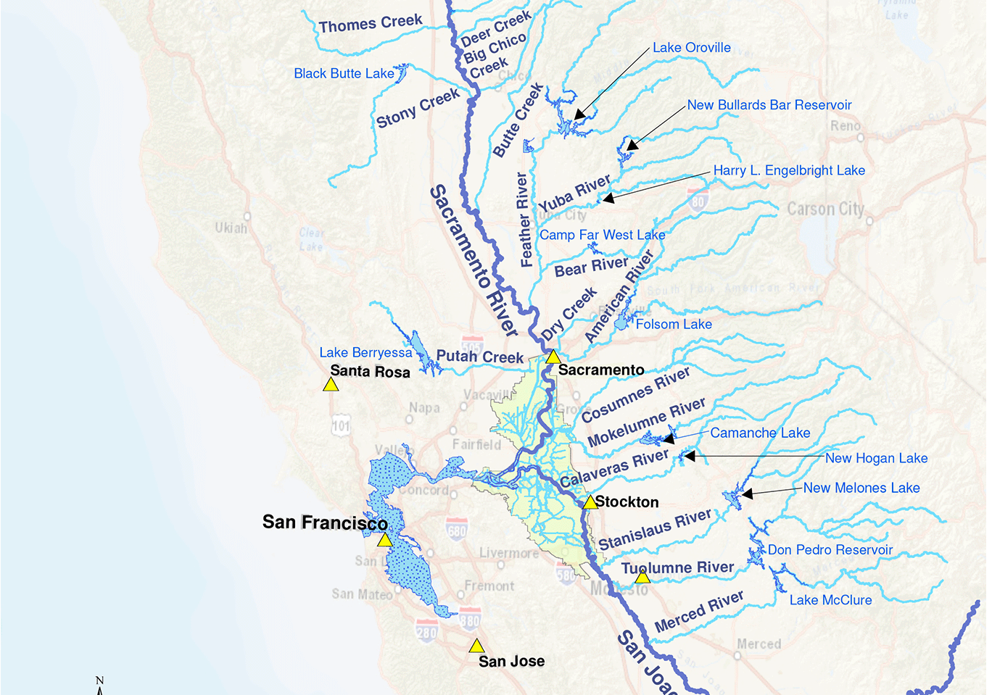
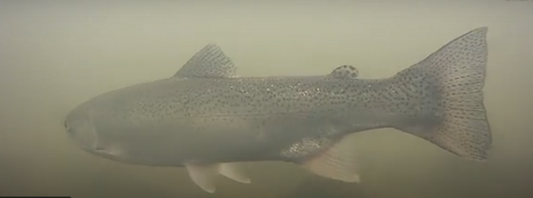
What challenges do we face?
Sustainable Groundwater Management Act (SGMA)
Endangered Species Act (ESA)
Bay-Delta Plan
Future Weather Patterns
Notes:
Juan pass to justin after slide

Slide 8
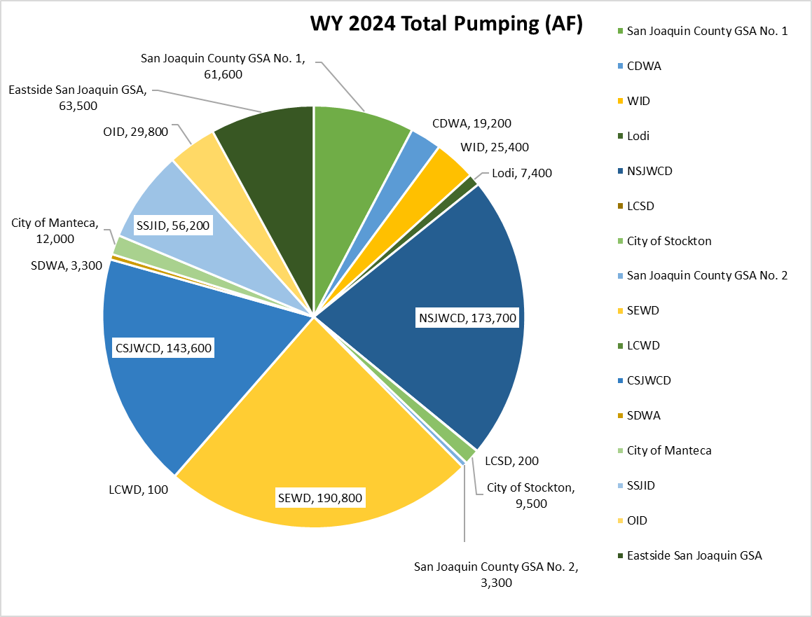
SGMA Update
WY 2024
Hydrologic Conditions: WaterYear 2024 was only slightlywetter than average andclassified as an above normalwater year.
Groundwater Use: Groundwater extraction and use was estimated to be 799,476 AF for the Eastern San Joaquin Subbasin.
Groundwater Storage: Storage in the Eastern San Joaquin Subbasin decreased by approximately 55,000 AF.
Notes:
I'd like to begin with an update on the Sustainable Groundwater Management Act or SGMA
SGMA – must reach sustainability by 2040
SEWD is one of 16 Groundwater Sustainability Agencies (GSA) in the basin
SEWD is one of the largest GW users in the basin – shown in yellow pie slice at bottom
Ag customers pump about 135TAF of GW annually
In WY2024 (Oct 2023 through Sept 2024), slightly wetter than average:
Almost 800,000AF of GW pumped
SEWD was almost ¼ of that @ 190TAF
Number is a model estimate that includes domestic well use, overpumping to account for irrigation efficiency, and model error
GW storage was estimated to decrease by 55TAF

Slide 9
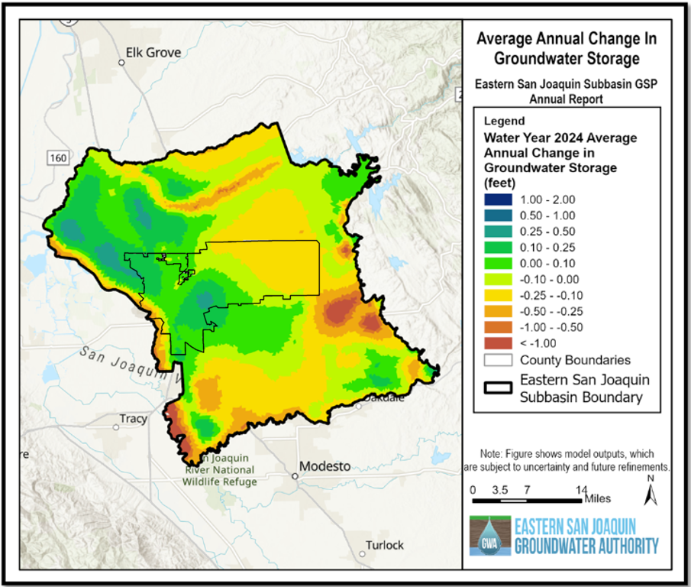
SGMA Update
SEWD RECHARGE
Overall Status: Five-year periodic evaluation and GSP update complete.
Groundwater Levels: Groundwater elevations were maintained throughout WY 2024 for almost all wells in the representative monitoring network (RMN). One well reported groundwater levels below the minimum thresholds by less than one foot.
Groundwater Quality: All measurements reported were within water quality compliance.
Notes:
We are making progress towards sustainability – as shown by this change in storage map: the darker the green or blue = greater increase in groundwater level; the yellow to red = greater decrease in gw level.
The basin also completed a GSP update and submitted the first 5-year periodic evaluation earlier this year.
Through the periodic evaluation process, many GSAs reported undertaking projects to increase surface water use in the region and SEWD is leading this effort.
SEWD’s primary focus is in-lieu recharge, or the process of using surface water instead of groundwater.
Through various programs and conscientious customers, we have converted nearly 16,000 AF of annual demand from GW to SW, since 2020
Over the next eight months we hope to convert an additional 4,000 AF of demand to achieve our GSP goal of 19,000 AF annually of in-lieu recharge.
Some concerns were identified during the 5-year evaluation process:
1. Progress – a couple of GSAs doing little or nothing
2. With GSP update and Periodic evaluation, we’re required to provide detailed demand reduction (curtailment) framework
SEWD & NSJ are leading the effort to develop framework
3. A model update concludes additional gw demand reduction is required
As a basin, reduce groundwater pumping by 56TAF-166TAF, depending on model scenario - with or without climate change.
•This is above and beyond the GSP projects, which decrease GW demand about 34TAF annually.
•That would bring the total gw demand reduction to a range of 90TAF to 200TAF annually.
SEWD share would be 21TAF-56TAF annually.

Slide 10
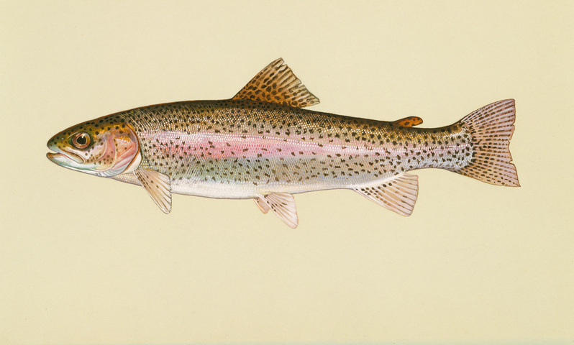
Endangered Species Act
ESA – federal regulation to protect endangered species determined.
ESA prohibits the 'take' of an endangered species.
Our HCP was developed to comply with the Endangered Species Act.​
The HCP requires minimum flows in the Calaveras River, which uses a little more than 14,000 AF of NH SW supplies annually.
DO NOT “TAKE”
Notes:
ESA – federal regulation passed in 1973 to protect species determined endangered by federal government
Federally protected specie in Calaveras River – Central Valley Steelhead – not allowed to 'take' central valley steelhead without an ITP
“Take” of central valley steelhead is costly (up to $28,000 per take) and could limit access to New Hogan Reservoir surface water supplies – what is take?
The Federal definition of Take is, “means to harass, hunt, shoot, capture, trap, kill, collect, wound, harm, or pursue an ESA-listed species, or attempt any of these activities.”
Developed HCP to receive a 50-yr ITP to allow for our continued operation of Calaveras River and sustain access to NH SW supplies
HCP established minimum flow requirements, which use about 14TAF of our NH SW supplies, annually

Slide 11
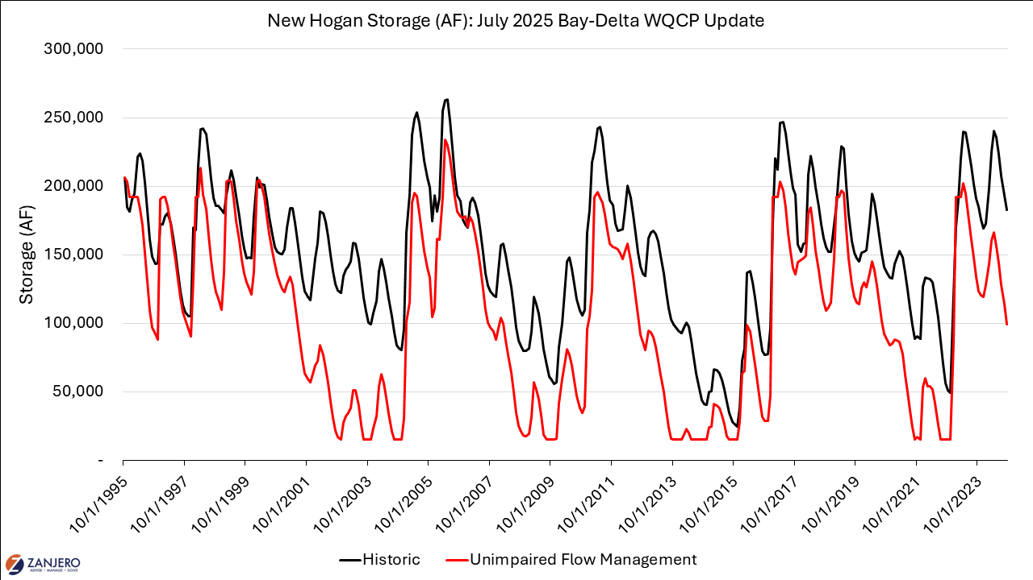
Bay Delta Plan
Water Board plan to maintain Sacramento-San Joaquin Delta water quality.
55% unimpaired flows on Calaveras River would result in essential loss of New Hogan Reservoir storage.
HRL proposal (formerly VA), but still likely to lose ~10TAF annually for Delta flows.
Notes:
Bay-Delta Plan
California State Water Resources Control Board plan to protect fish and wildlife in the Sacramento-San Joaquin Delta
Flow centric – focuses on up to 55% of natural flows be unimpaired – can’t divert or store
55% unimpaired flows on Calaveras River would result in essential loss of New Hogan Reservoir storage, SEWD’s most reliable SW supply, as you can see on this chart
SWRCB solution to loss of SW supply = pump more GW; apparently the LH isn't talking to the RH, as this is in direct conflict with SGMA
Calaveras River only accounts for 0.2% of total Delta flow – so we think this is an unreasonable requirement
As such, working with SWRCB on a HRL proposal, formerly known as a VA.
Still expect to lose ~10TAF annually of supply
W, AN – 100TAF end of Sept storage
BN, D, C – 50TAF end of Sept storage

Slide 12
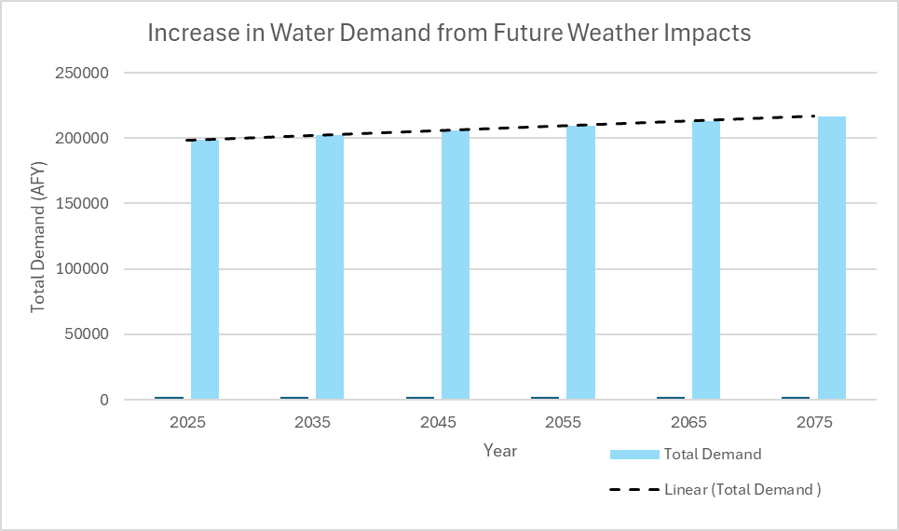
Future Weather Patterns
Expected increase of 2 degrees Celsius and same average precipitation over the next 50 years.
Still expect fluctuation between years
Current water demand is 198,580 AFY
Future water demand would increase by 18,165 AFY.
Notes:
SEWD has been working with DWR to project the impact of future changes to weather patterns within the Calaveras River watershed
Expectation over the next 50 years is sustained precipitation but 2*C temperature increase = higher crop ET
If temperature increase materializes, crop ET is projected to increase a little more than 18TAF annually by 2075

Slide 13
Surface Water Summary
Water Supply/Demand | Total (AFY)
New Hogan | +80,000 (+/-)
New Melones | +90,000
Ag & Municipal Demand | -115,000
Increased Surface Water Demand for SGMA Projects | -56,000
Increased Demand for ESA | -14,000
Increased Demand for Bay Delta Plan | -10,000
Increased Demand due to Future Weather Patterns | -18,000
Sum of supplies and demands | -43,000
Notes:
In summary, we have a greater potential SW demand than we have supply, on the magnitude of 43TAF annually on average.
Important to note that this is an average and assumes full allocation from both of SEWD's surface water supplies
On NH, the more CCWD uses, the less supply SEWD has, as we are currently using a majority of CCWD's allocation
On NM, the 2021 USBR Water Shortage Policy results in a NM supply in only 55% of water years
Thankfully, SEWD is working on several regional benefit projects to ensure existing supplies are fully utilized and new supplies are developed to meet the future water demands.

Slide 14
District Solutions and Priorities

Slide 15




District Planning Efforts
Calaveras River Habitat Conservation Plan (2020)
Strategic Plan (2023)
Water Supply Master Plan (2024)
20 Year CIP (2024)
Eastern San Joaquin Groundwater Sustainability Plan (2025)
Notes:
Juan

Slide 16
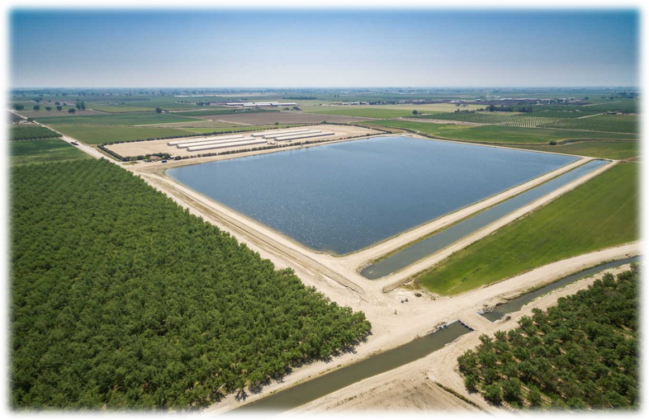
2025 Priorities
Secure CIP funding plan sources and conduct a District wide rate study to support funding needs.
Complete or secure commitments to meet the GSP in-lieu recharge goal of 19,000 AFY
Advance the Farmington Reservoir Project Feasibility
Collaborate on a new drinking water supply contract.
Ensure completion of all projects, plans, and studies identified in the FY 2025-2026 budget.
Enter into a Memorandum of Understanding for a Groundwater Banking Partnership
Meet all established Key Performance Indicator (KPI) goals.
Notes:
Juan
4. to... Develop a mutually acceptable water supply contract, integrate the District's funding plan with the Urban Contractors Schedule, Develop complementary Urban Water Management Plans.

Slide 17
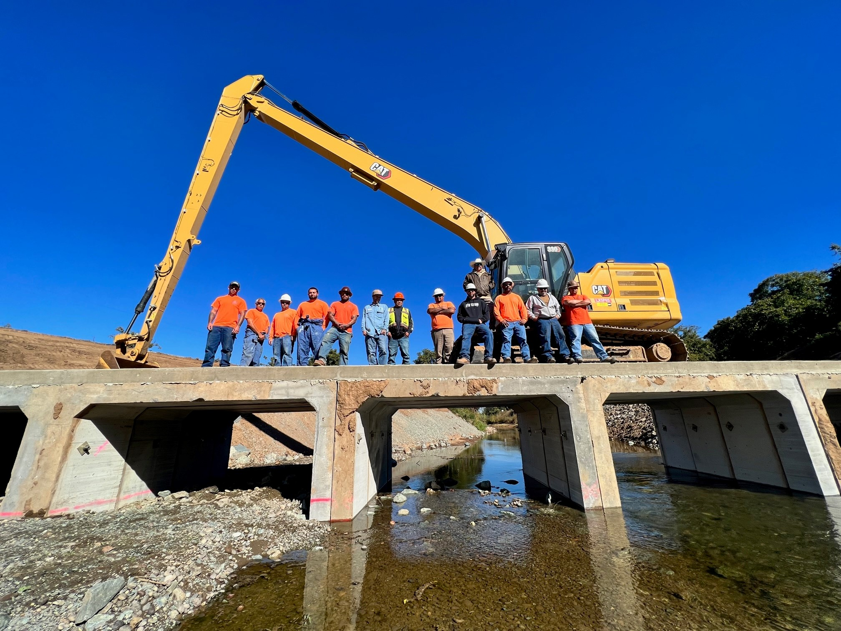
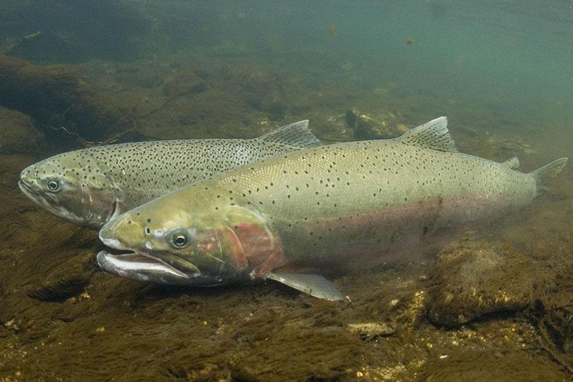
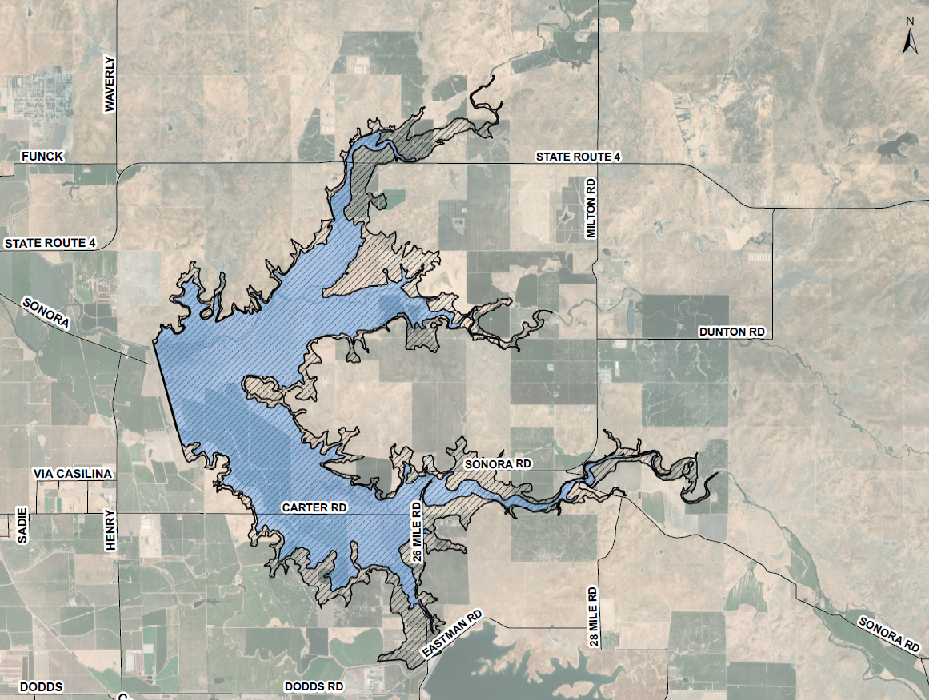
How do we respond to challenges?
Fish Passage Projects (HCP)
Securing New Water Sources
Securing Funding Sources
Capital Improvement Projects
  Infrastructure replacement
Recharge Projects
  Direct
  In-Lieu
Notes:
Juan
Projects
Construction of an Aquifer Storage and Recovery Well
Construction of West Groundwater Recharge Basin
Continued operation of WTP Recharge Reservoirs
Replacement of Low Water Crossings as part of the HCP for improved fish passage
CCTR (Complete)
Hosie Low Water Crossing (Complete)
Watkins, Fujinaka, and Hogan Low Water Crossings to be complete within 2 years.

Slide 18
Phytophthora Study Presentation

Slide 19
District Solutions and Priorities

Slide 20
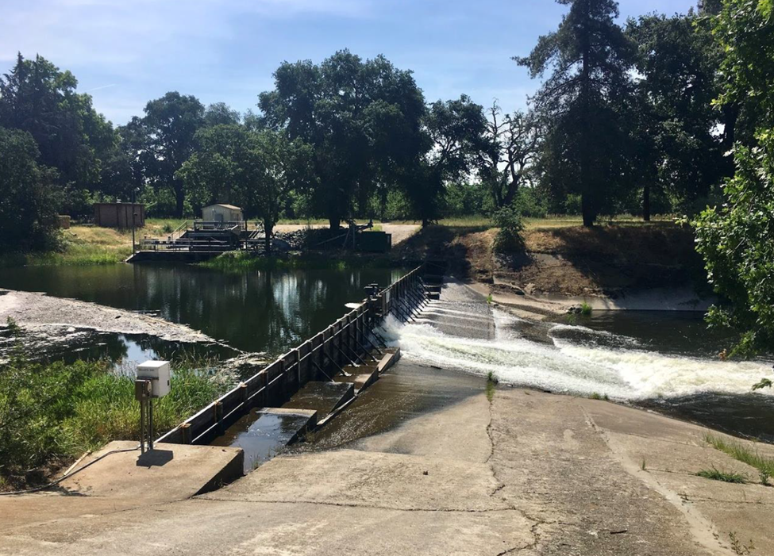
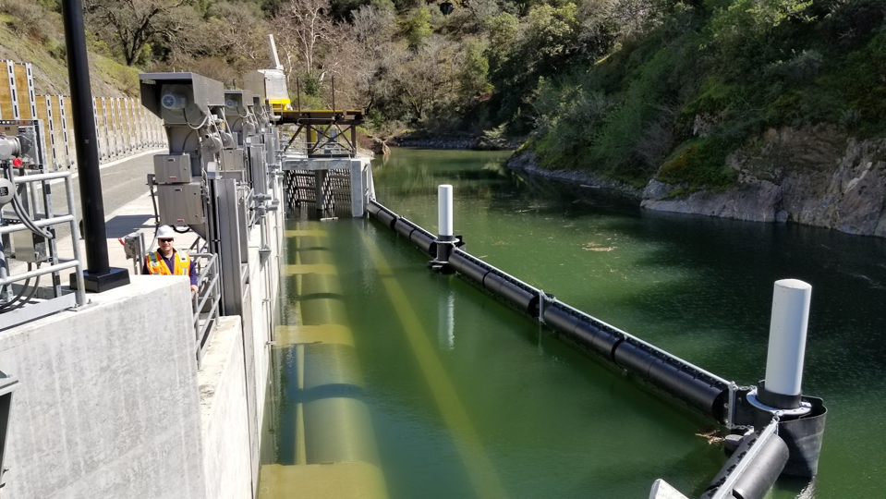
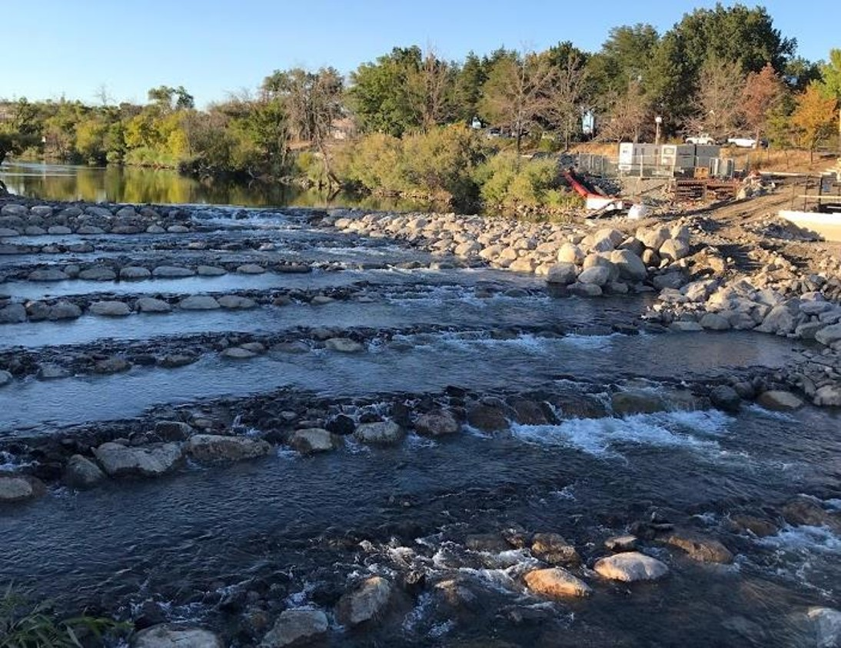
Bellota Weir Modification Project
Calaveras River Habitat Conservation Plan
Notes:
As mentioned by Juan previously the Bellota Weir Modifications Project fulfills the ESA and HCP requirements, but it also replaces critical infrastructure for distribution that is decades past its useful life.
Yesterday, we were able to hold a successful groundbreaking ceremony at the project site with local dignitaries, elected officials, and project partners.
The construction is going to start next month and it is an estimated total cost of $73,000,000, with $12,000,000.
Explain the pictures.

Slide 21
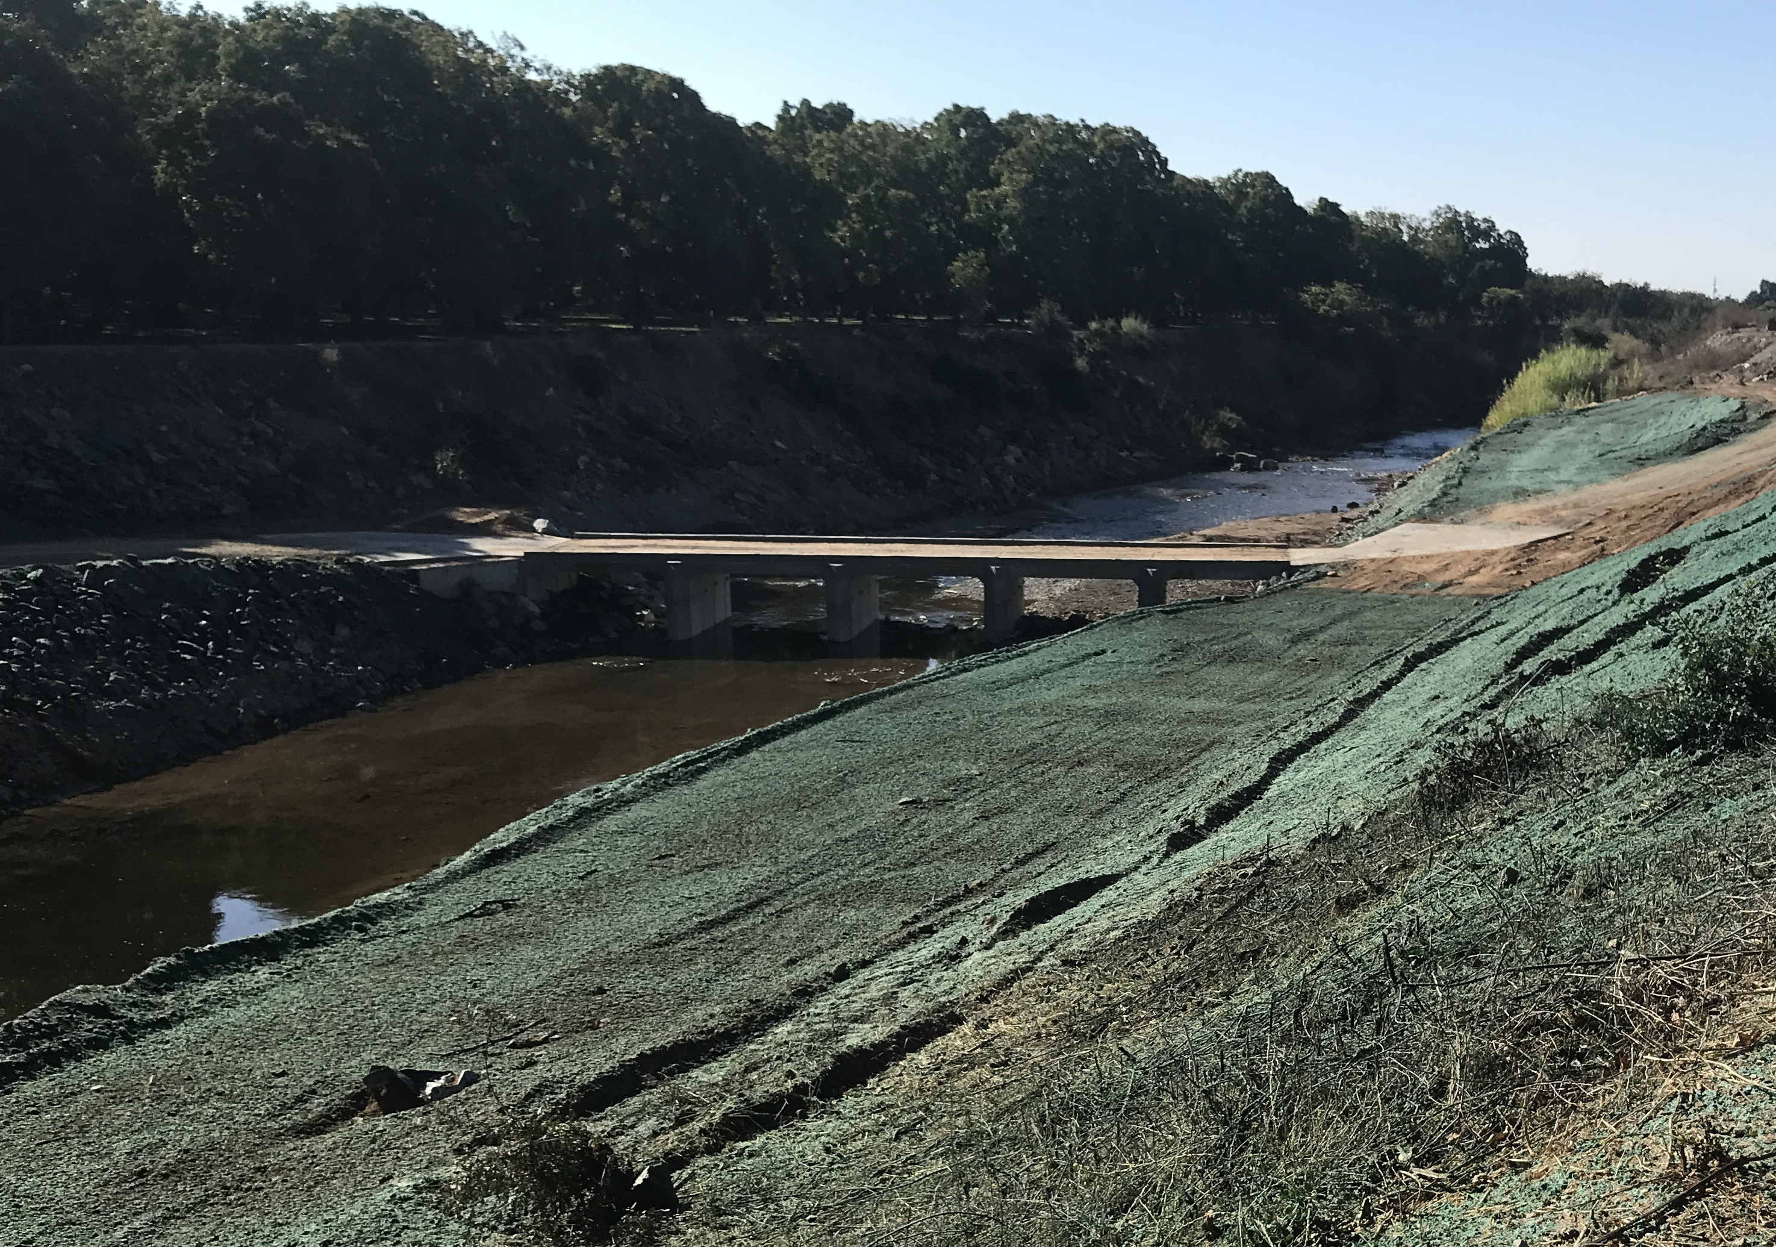
Low Water Crossings for Fish Passage
Hosie Low Water Crossing (Complete)
Caprini Low Water Crossing (Complete)
CCTR (Complete)
George Watkins Low Water Crossing
McGurk Low Water Crossing
Hogan Low Water Crossing
Fujinaka Low Water Crossing
Calaveras River Habitat Conservation Plan
Notes:
Chris
This fulfills our requirement of the habitat conservation plan, providing adequate fish passage for the central valley steelhead.
Our in house construction team has completed three of the projectsfinal 4 projects over the next two years.

Slide 22
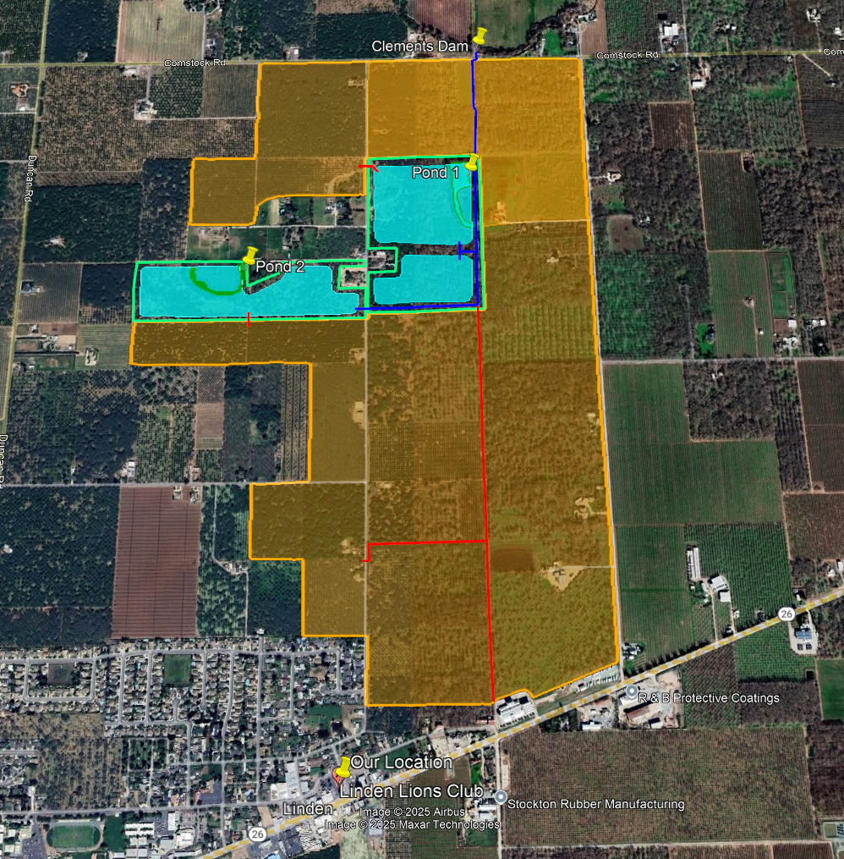
Clements Pipeline and Reservoir Project
$188,920 in grant funding to complete the design work
Hired Provost and Pritchard Engineering
Supply surface water to up to 600 acres, reducing groundwater pumping by approximately 1,680 AFY
May include a regulating reservoir and recharge reservoirs.
Notes:
Chris
United states bureau of reclamation, USBR, awarded a project planning grant in the amount of $188,920 for the design work of this project.
Provost and Pritchard Engineering to complete a Preliminary Engineering Report that investigates and analyzes different project alternatives
Potentially purchasing two parcels along the pipeline alignment to install large recharge reservoirs that may also be used as regulating reservoirs to improve water delivery timing downstream of Clements Dam.

Slide 23
Farmington Reservoir Project
Repurpose the Farmington Flood Control Dam to create year-round water storage and capture winter storm water for beneficial use and recharge
Would convert approximately 6500 acres into a recharge and storage reservoir
The implementation of this project would be a combined effort between SEWD and the US Army Corps of Engineers
Notes:
Largest project is Farmington Reservoir Project – located on Littlejohns Creek outside town of Farmington
•With support from our Congressman, Josh Harder, the 2024 WRDA bill included authorization for USACE to restudy Farmington Dam as a water storage facility
•Study previously completed in 1998, but we think the feasibility of the project has changed due to several developments over the past 27 years: SGMA, CVP allocation policy, USACE charged with water supply, renewed focus on water storage at state and federal levels.
•Proposed project would improve existing Farmington Dam to allow for water storage – currently just flood control – increase storage to 112TAF
•Have pending water right applications filed for water in Littlejohns Creek watershed to create new water supply
•Would also provide ‘parking space’ for CVP supply from New Melones Reservoir
•With 2021 USBR Water Shortage Policy, SEWD either receives all 75,000AF or 0
•Historically use 40-45TAF of CVP supply
•Store unused supply in case next year is a dry year and 0 allocation is received

Slide 24
Funding and Programs

Slide 25
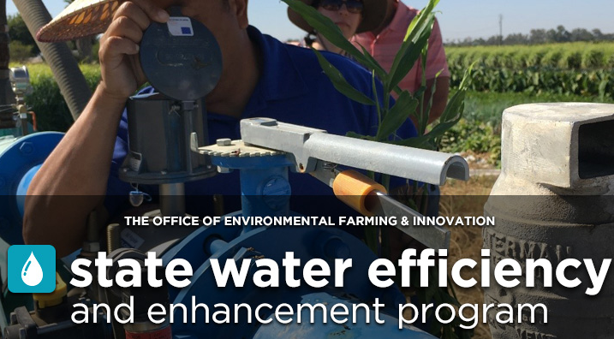

SWEEP Block Grant
In collaboration with NSJWCD and SSJID a total of 22 projects have been awarded (13 of which are within SEWD)
This program brought $5,000,000 in funding to the region.
The selected projects include installing surface water pumps, solar energy, soil moisture sensors, weather stations, VFDs, and flowmeters.
Total groundwater savings of approximately 7,500 AFY (4,300 AFY SEWD)
Application Period Now Closed.
Notes:
First off I'd like to recap the State Water Efficiency and Enhancement Program.
It has been a very successful program that we partnered with NSJWCD and SSJID.
We were able to award about 22 projects, 13 of which are within Stockton east water district.
This program brought about 5,000,000 dollars into the subbasin for projects that conserve water and energy.
The application period is now closed, the awarded projects will be completed by January 2026.
This next slide will make some people in this room very happy or excited, but before I click to it I would like to first thank our board members for making it possible. So without further delay, I would like to introduce you all to the Surface Water Enhancement Grant.
1,550 AF of water conserved from efficiency improvements.
$4,800,000 used for projects

Slide 26
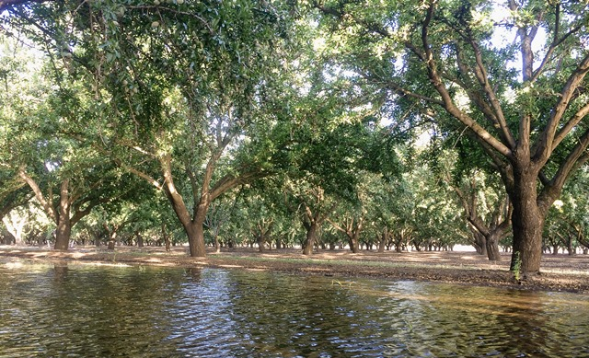
Surface Water Enhancement Grant
New Opportunity!!
$1,600,000 available!!!!
Grant opportunity for surface water infrastructure.
Total Grant Funds Available - $1,600,000
Maximum award per project - $200,000
Approximately 10 projects will be awarded
Applications are now open!!!! All grant information and application documents can be found on the District’s Website. (https://www.sewd.net/surface-water-enhancement-grant )
Applications will close September 26th, 2025
This will be a competitive selection process, each application will be scored and ranked.
Notes:
This grant is exclusively brought to you by Stockton East Water District and is solely for our customers.
This program is for projects that install infrastructure to access surface water.
The max grant amount per project is 200,000. We are hoping to award about 10 projects.
This will be a competitive application process, so each application will be scored and ranked on specific criteria's.
The highest scored applications will be awarded. All of the application information can be found on our website, the application, budget template, and informational document.
My contact information is on the website as well so feel free to reach out with any questions regarding the application or process.
The applications will close on September 26th.
Thanks to our board and their leadership we have been able to bring this program to life. The District is proud to present the Surface Water Enhancement Grant opportunity!!!! The Surface Water Enhancement Grant (Surface Water EG) is a new opportunity exclusive to our district that will provide funding for projects install infrastructure to surface water for farms that currently use groundwater. Through the Surface Water EG program SEWD aims to support local and regional efforts to conserve groundwater and improve water efficiency by providing funding to local growers.

Slide 27

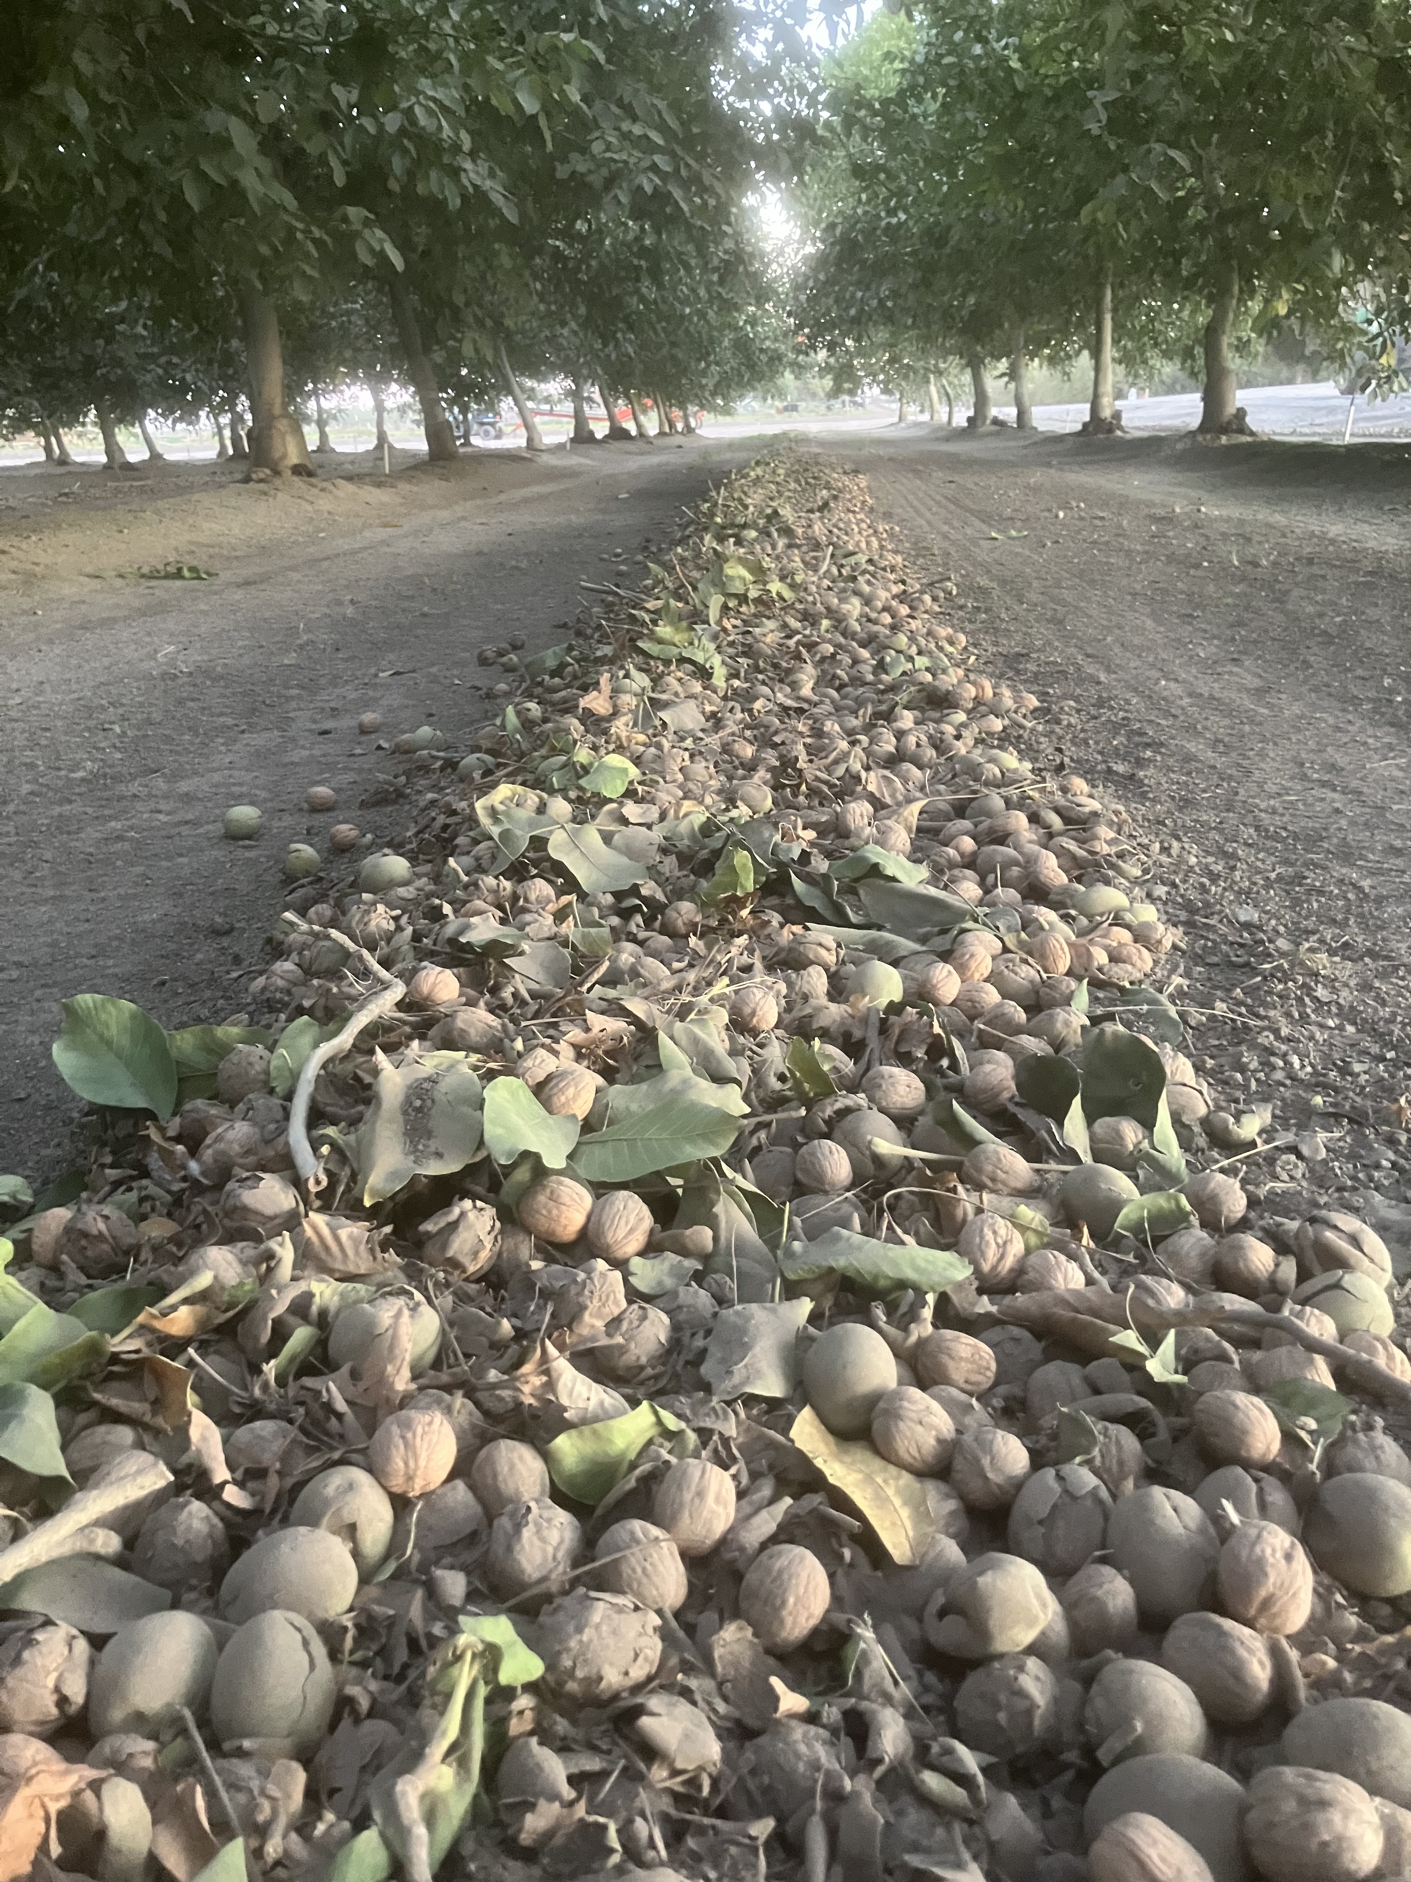
Surface Water EG Eligible Projects
Any project that involves converting an existing farm from groundwater use to surface water use. Examples of eligible projects include but are not limited to the following:
Converting from a groundwater source to surface water.
Installing a new surface water pump
Installing new piping to access surface water
Rehabilitating an existing surface water pump that is not currently being used or expansion of existing surface water infrastructure.
Notes:
As previously stated this opportunity is specific to installing infrastructure to access surface water. This does not only mean new turnouts, this could also be upgrading an existing pump to supply surface water to more acres, or a replacement of an old surface water pump that hasn’t been used in a long time.

Slide 28
District Programs –
On-Farm Recharge Policy
In 2024, the District approved a cost recovery program for growers that can recharge surface water between November 1st and April 30th.
Lifted Diversions – Landowners will receive payment of $80 per acre-foot of measured net recharge and a groundwater credit equal to 50% of the measured net recharged volume. For example, if 100 acre-feet are recharged, the landowner will receive compensation of $8,000 ($80/AF x 100AF) and a 50 acre-feet groundwater credit and the District will benefit by 50 acre-feet.
Gravity Diversions – Landowners will receive payment of $25 per acre-foot of measured net recharge and a groundwater credit equal to 50% of the measured net recharged volume. For example, if 100 acre-feet are recharged, the landowner will receive compensation of $2,500 ($25/AF x 100AF) and a 50 acre-feet groundwater credit and the District will benefit by 50 acre-feet.
Notes:
This slide was presented last year as well, but I just wanted to remind you all of the on farm recharge program.
Thank you for those that expressed interest already.
This program offers money to anyone that has access to surface water and is able to apply water to their property between the months of November and April.
There is a set amount per AF for lifted diversions and a separate price for gravity feed diversions as well as a groundwater credit for both.
If you are interested please reach out or ask questions after the presentation.
With that I am going to pass it back to Justin for some closing remarks.

Slide 29
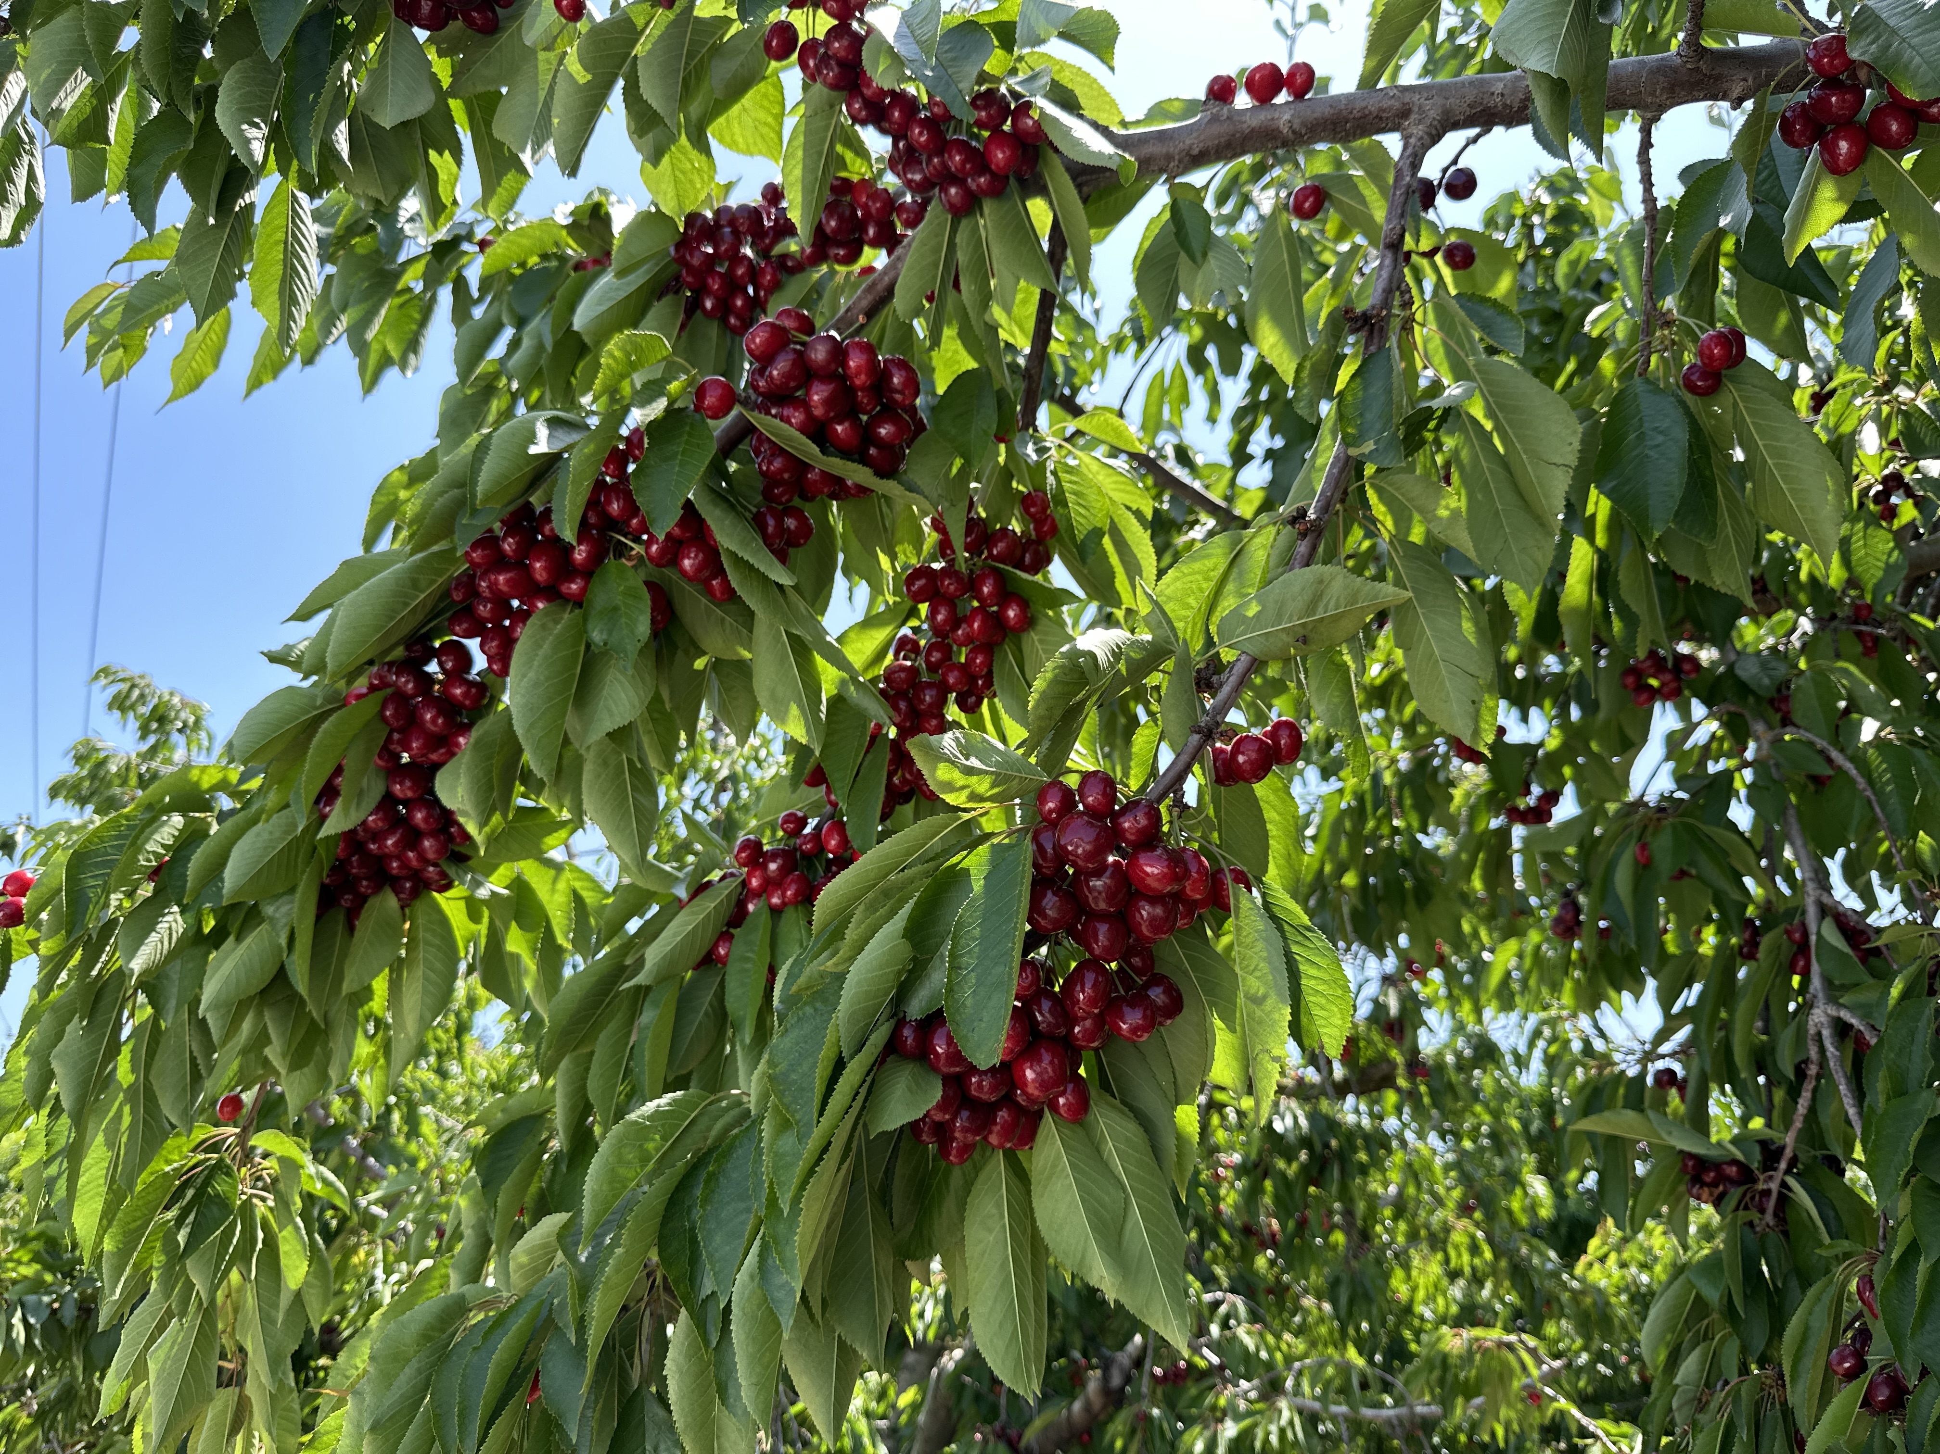
Thank You For Joining Us!
ThePhoto by PhotoAuthor is licensed under CCYYSA.

