Slide 1
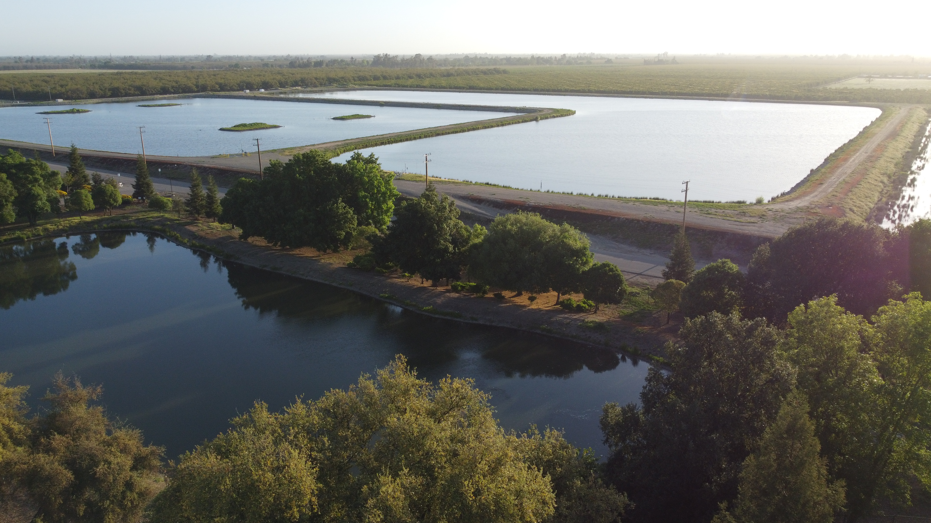
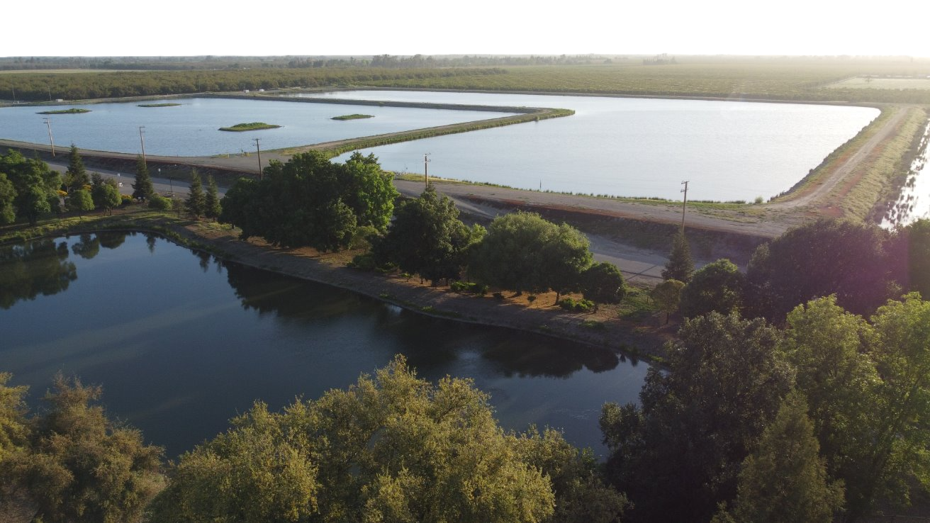


Annual Growers Meeting
July 2024
Linden Lions Club

Slide 2

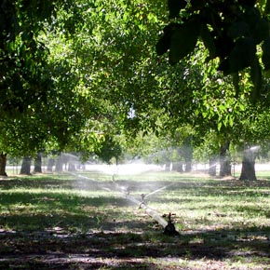
Meeting Agenda
Meet the District
  Introduction from Board President
  About Us
  What's happening now?
  Strategic Plan
Water Security Efforts
  Water Supply Master Plan
  Calaveras River Habitat Conservation Plan (HCP)
  California Sustainable Groundwater Management Act (SGMA)
Funding Opportunities
District Programs
Wrap up

Slide 3
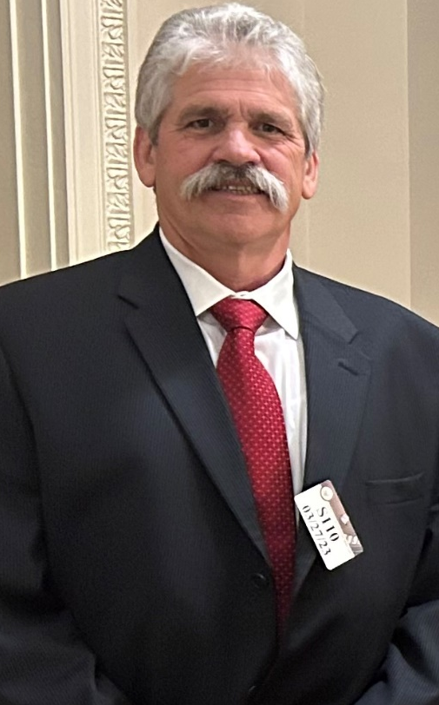
.
Welcoming Remarks
Richard Atkins, President
Board of Directors
Stockton East Water District

Slide 4
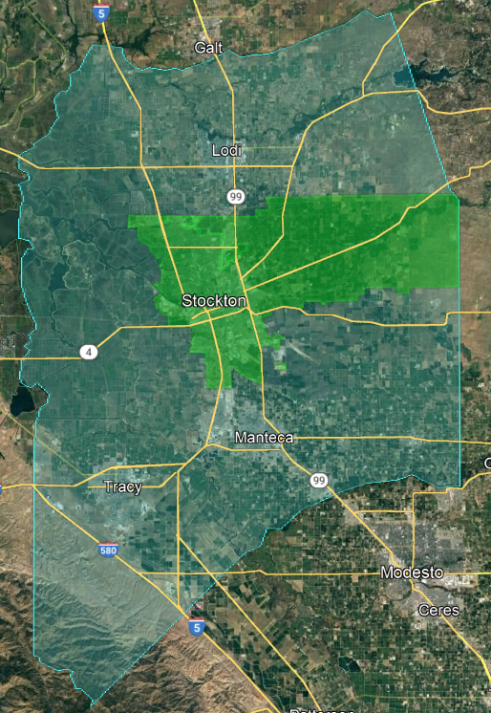
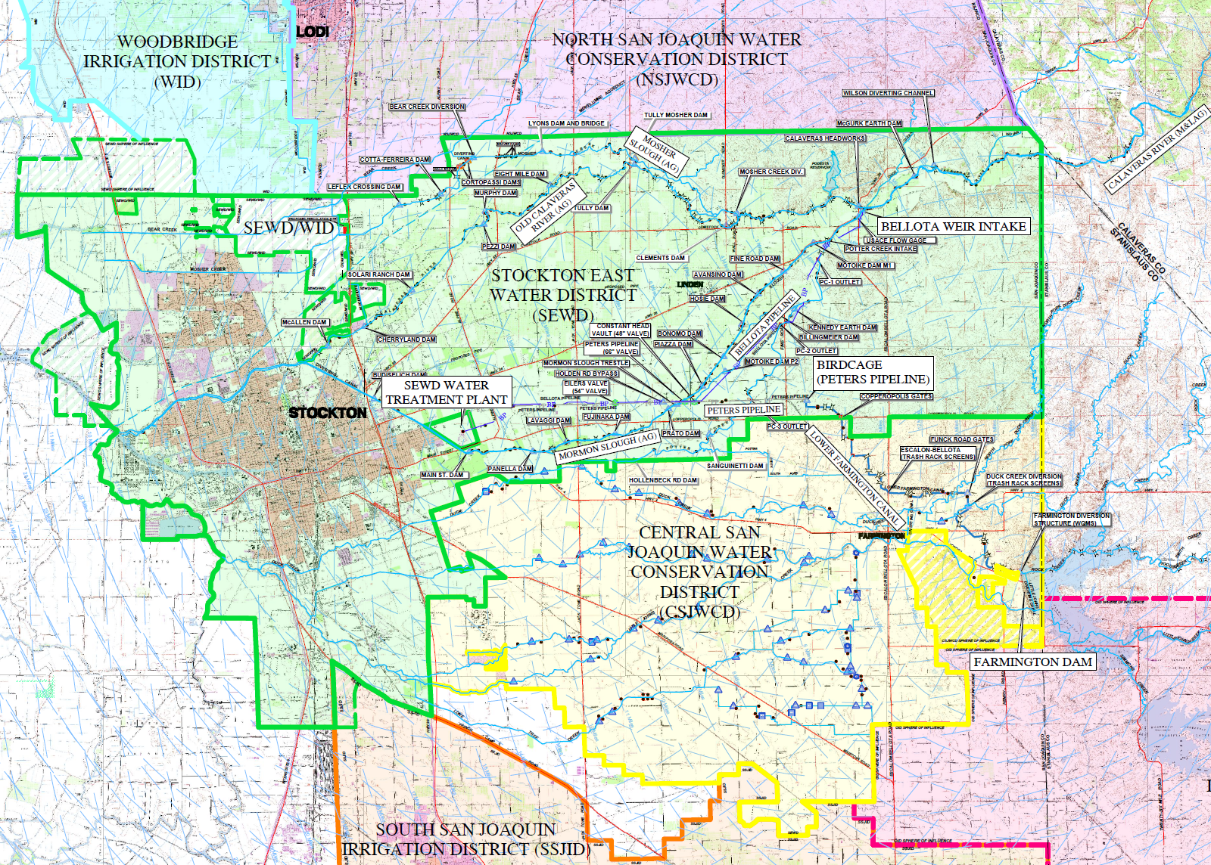
.
About Us
250 Surface Water Customers averaging 25,298 AF/year for the last three years.
1,150 Groundwater Customers averaging 134,919 AF/year for the last three years.
6,050 Domestic Groundwater Customers.
  Governance: Divided into seven divisions, each represented by an elected Director.

Slide 5
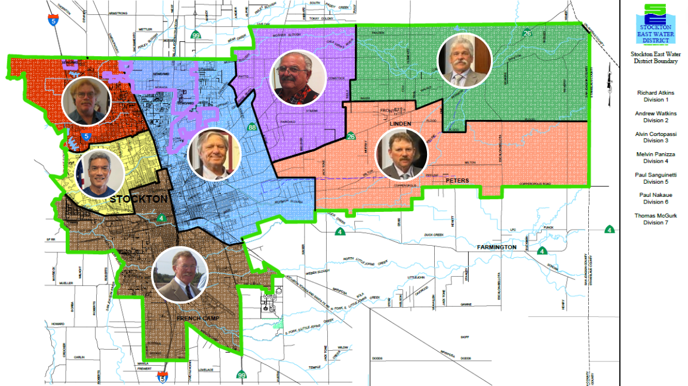
Meet Our
Board Members
Atkins
Division 1
Panizza
Division 4
Cortopassi
Division 3
Watkins​
Division 2
Nakaue
Division 6
Sanguinetti
Division 5
McGurk
Division 7

Slide 6
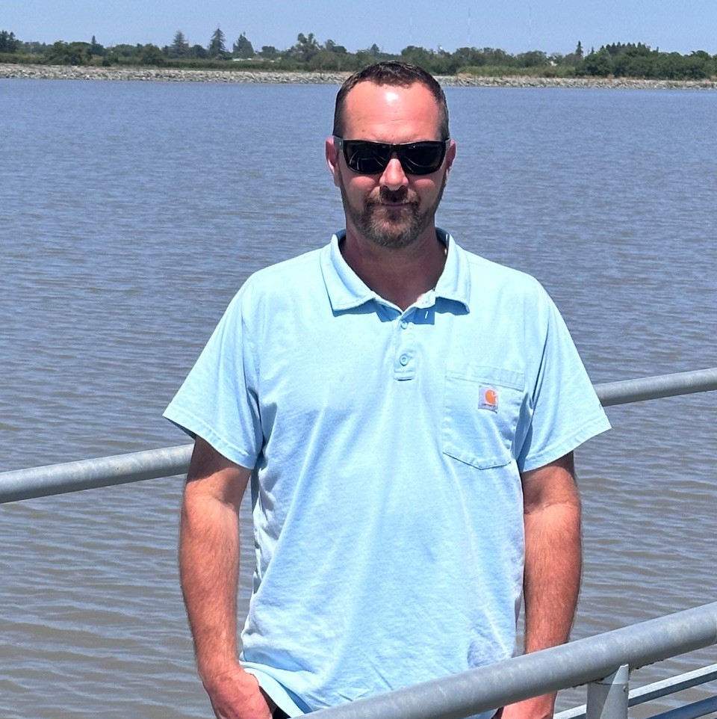
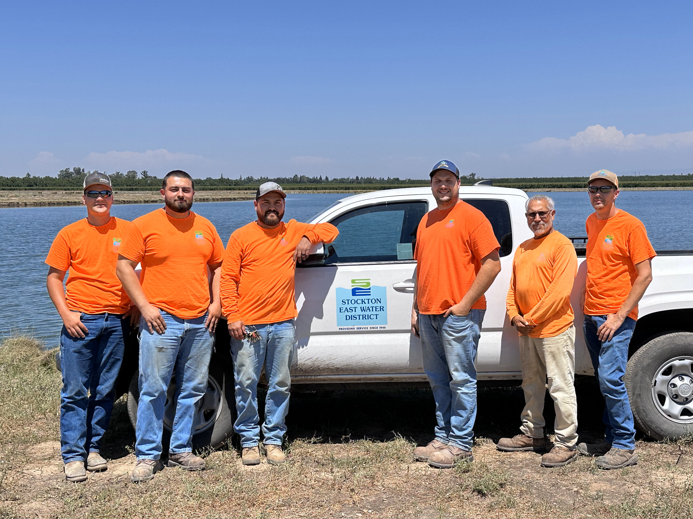
Water Supply Team
Chris Donis
Water Supply Manager

Slide 7
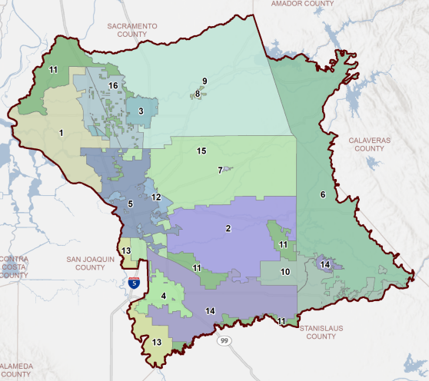
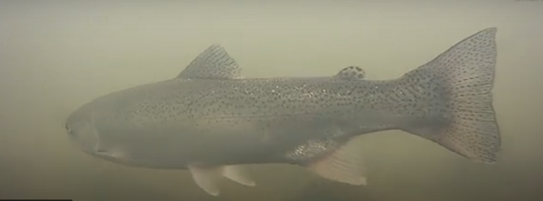
What’s Happening Now?
Sustainable Groundwater Management Act (SGMA)
Endangered Species Act (ESA)
Bay-Delta Plan
Legislation
DO NOT “TAKE”

Slide 8
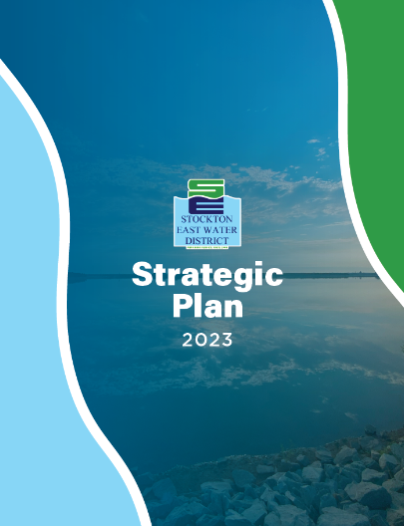
Strategic Plan
Adopted 2023
Reaffirmed Mission
Developed a Vision
Identified Strategic Areas

Slide 9

Our Mission
Our mission is to ensure sustainable groundwater, high-quality drinking water, and supplemental surface water for agricultural use.

Slide 10
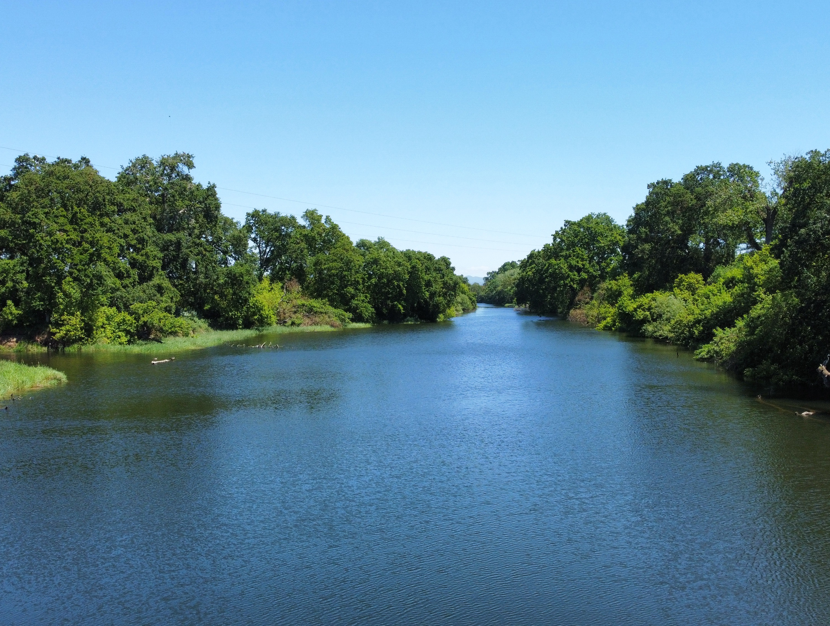
Our Vision
To be a regional leader and reliable partner by implementing innovative solutions for our agricultural and urban customers, securing existing and additional water resources, and achieving groundwater basin sustainability.

Slide 11




Strategic Plan
Resource Management
Reliable Infrastructure
Human Resource Management
Water Supply
Collaborative Partnerships
Regulatory Engagement

Slide 12
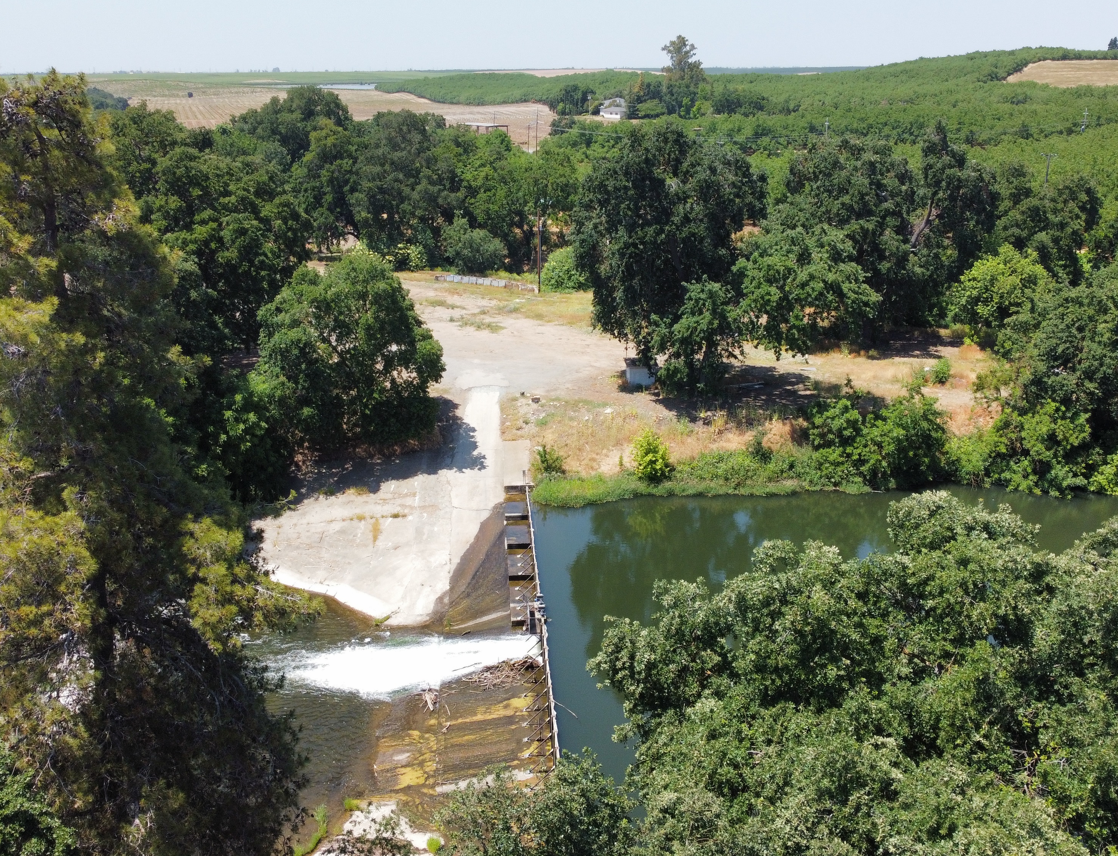
Water Security
Master Plans
Calaveras River Habitat Conservation Plan (HCP)
Eastern San Joaquin Groundwater Sustainability Plan (GSP)

Slide 13
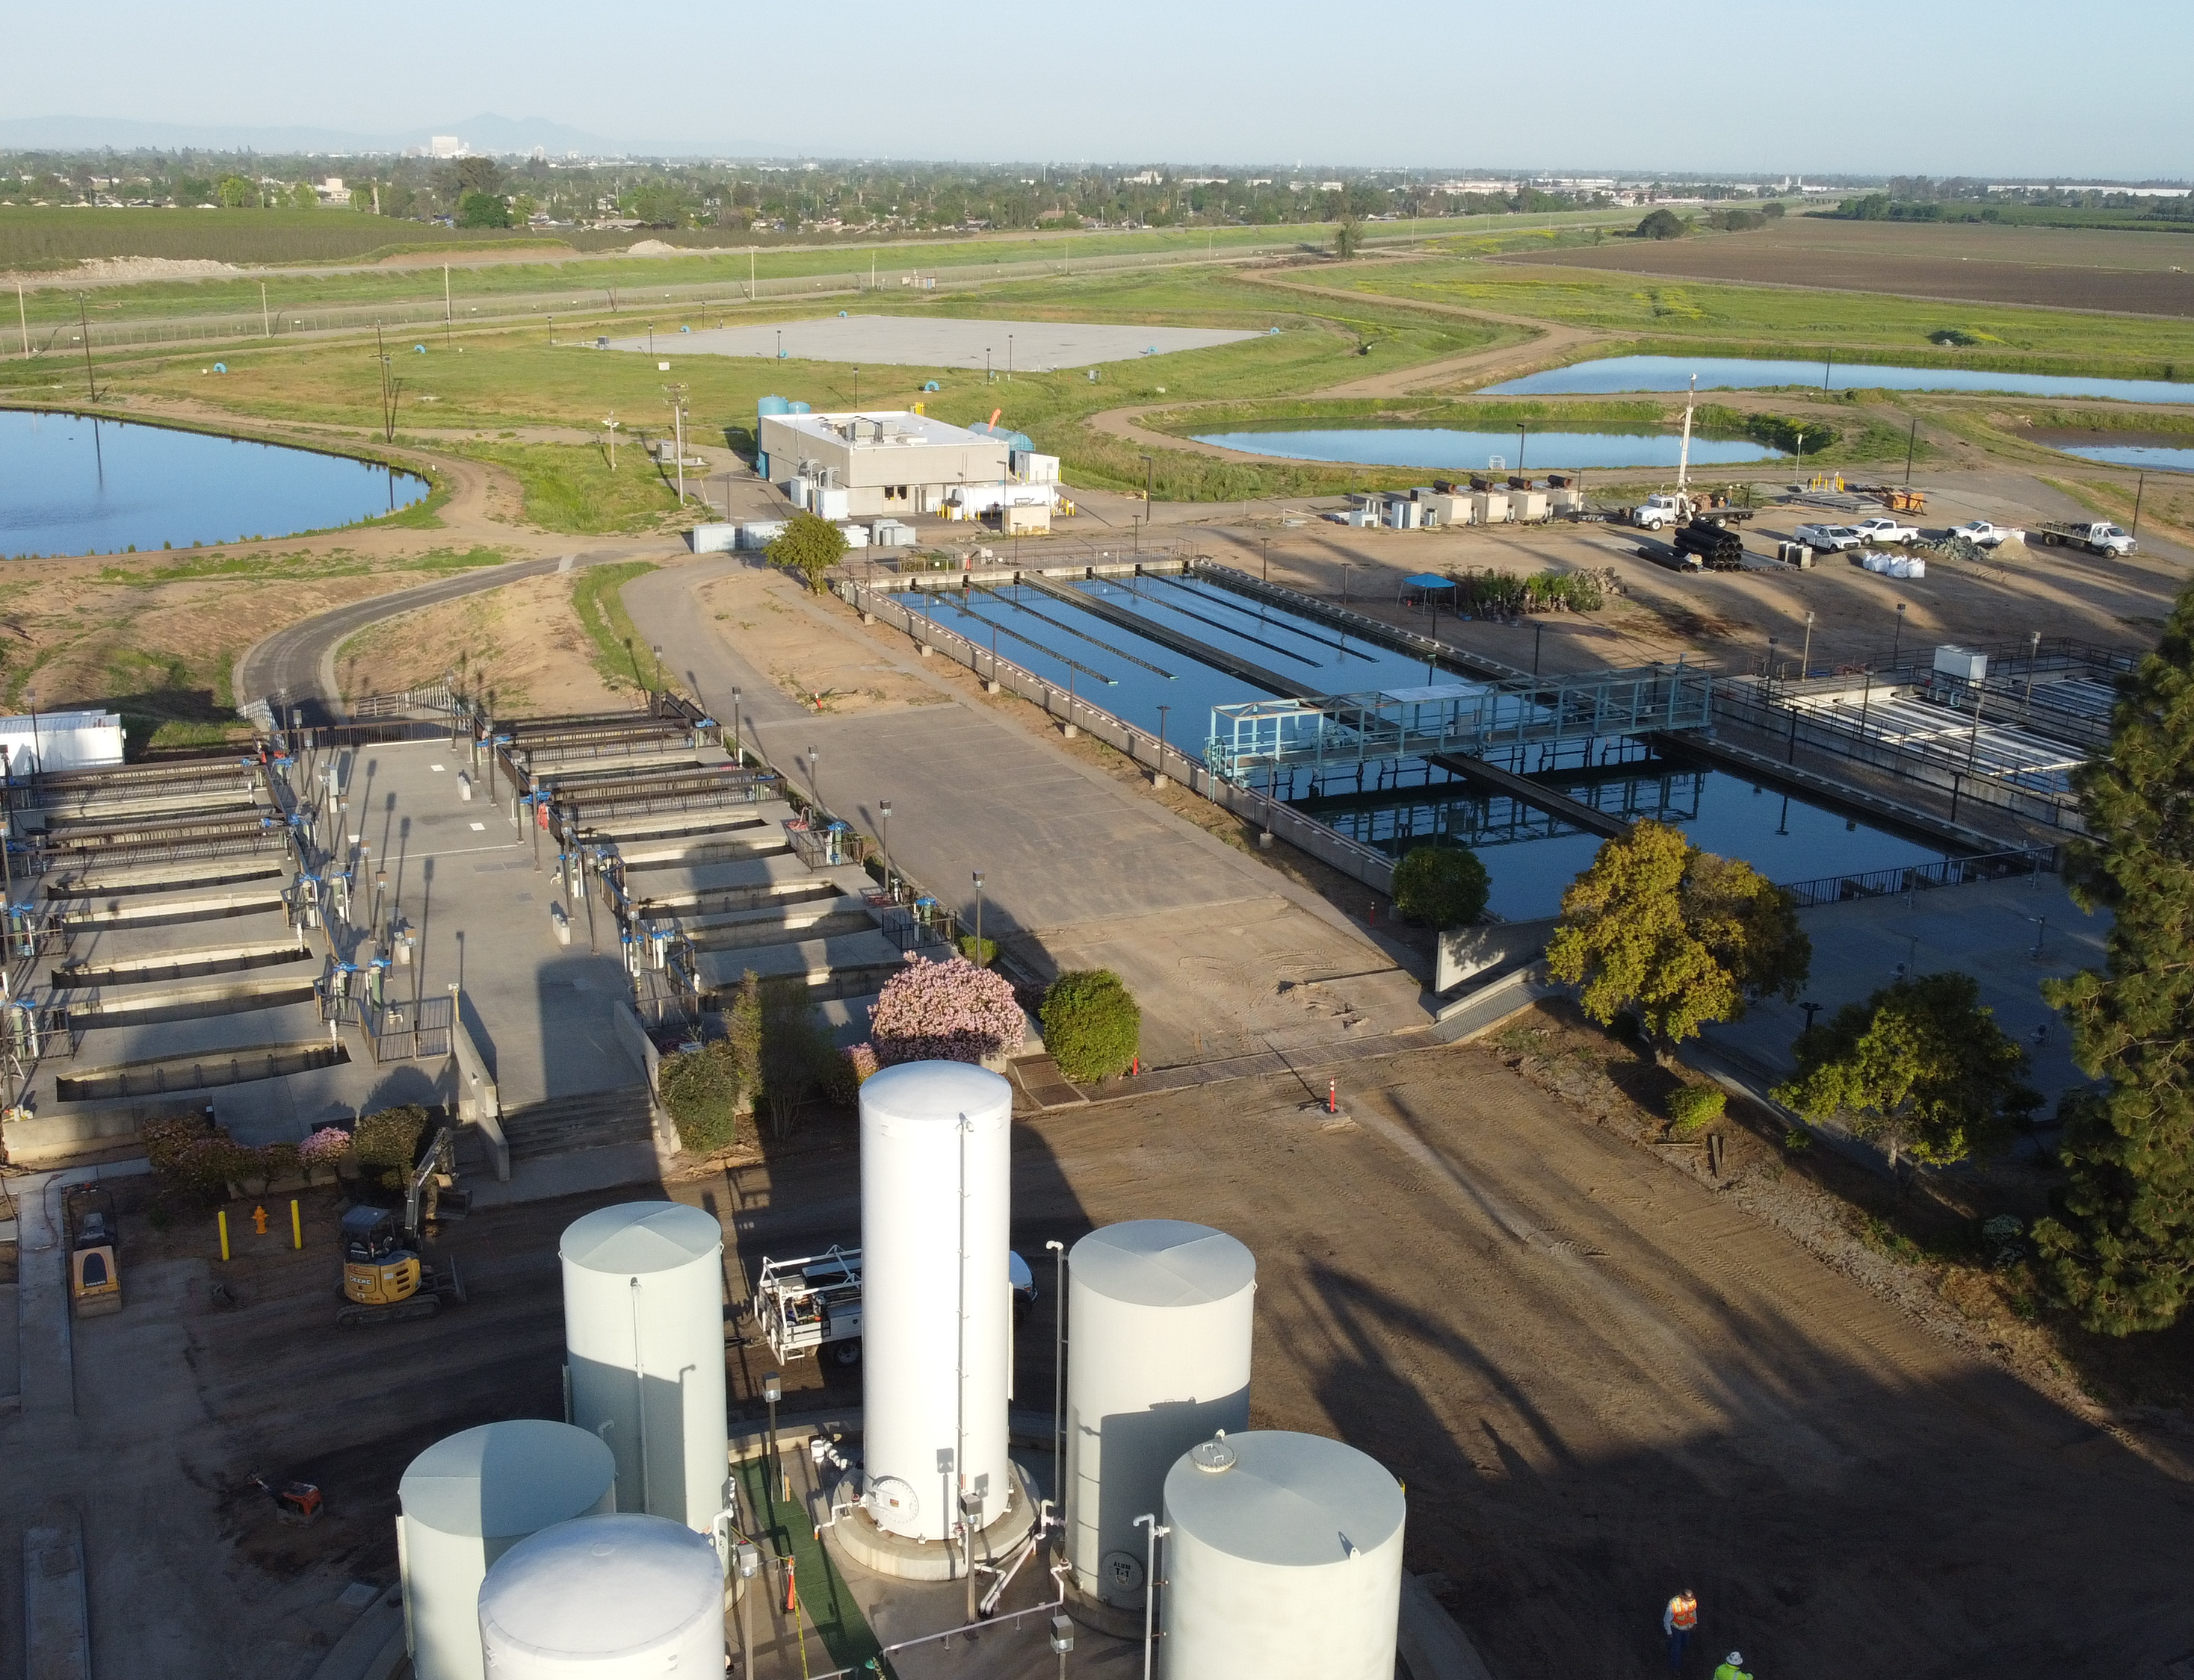
Master Plans
Water Supply & Water Treatment Plant Master Plans
50 Year Planning Horizon
20 Year Capital Replacement Program
Rate Stabilization

Slide 14
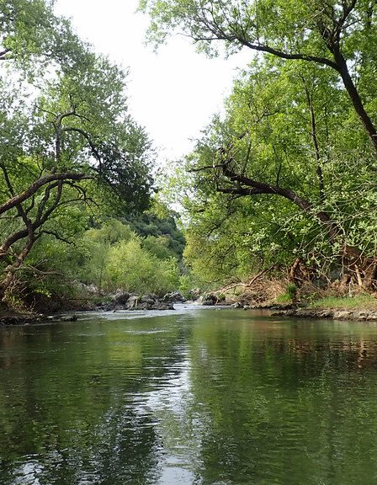
Calaveras River Habitat Conservation Plan (HCP)
SEWD + NOAA
Calaveras HCP
Incidental Take Permit
Continued Operation of Calaveras River

Slide 15
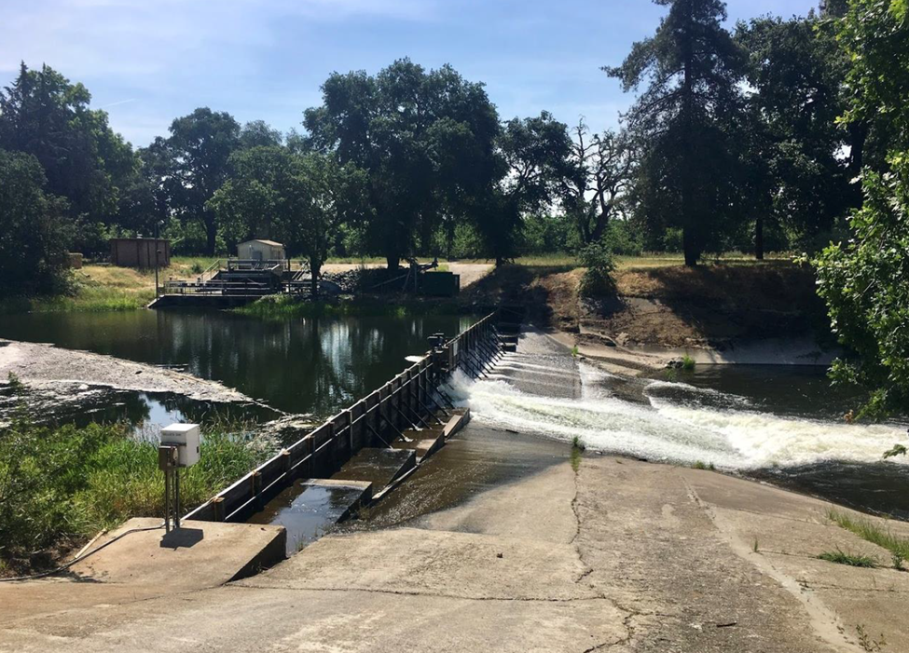
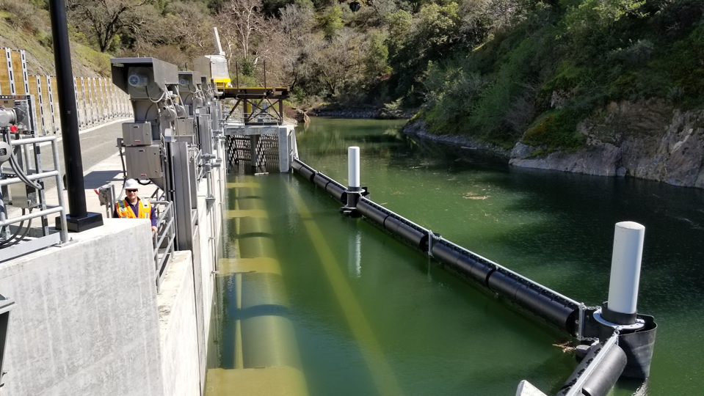
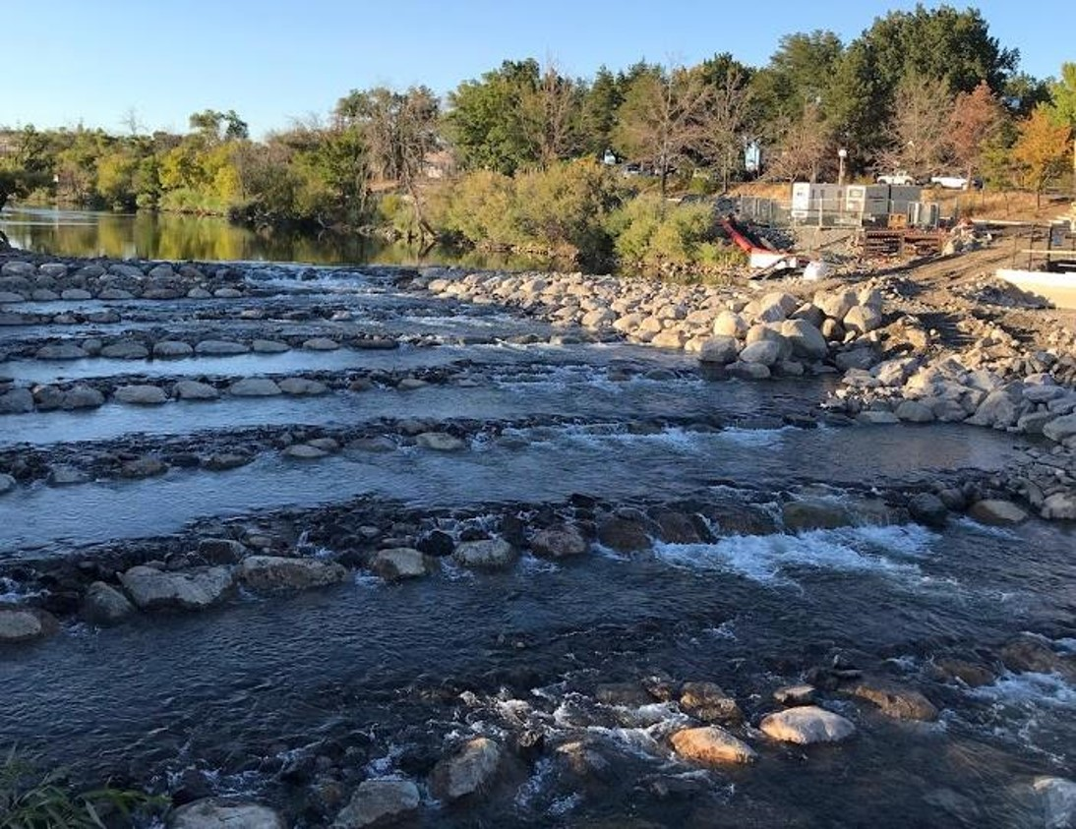
Bellota Weir Modification Project
Calaveras River Habitat Conservation Plan

Slide 16
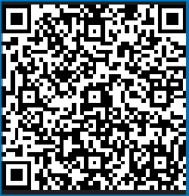
Sustainable Groundwater Management Act
Jan. 2020
July 2022
Every Year
Jan.
2025
2040
Implement GSP
(In Process)
GSP Approved
(Complete)
Submit Annual Report
(Every April)
Evaluate and Update GSP
Achieve Groundwater Sustainability
Occurring throughout GSP implementation:
Outreach and engagement
Monitoring and adaptive management
Projects and management actions
Need YOUR Help!
Survey Deadline 8/31/24

Slide 17
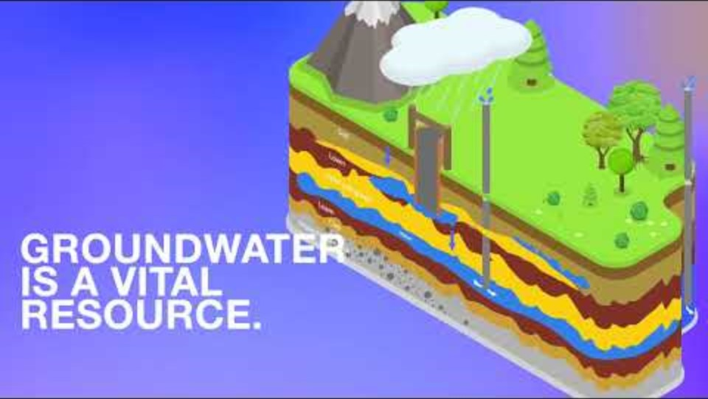

Slide 18
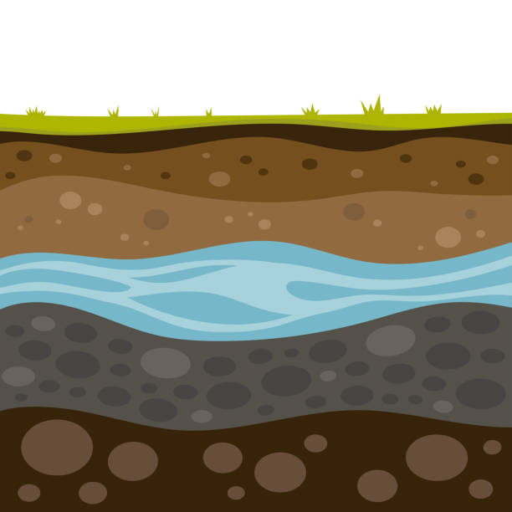
SGMA Groundwater Concerns
Land Subsidence
Lowering Groundwater Levels
Saltwater Intrusion
Poor Water Quality

Slide 19
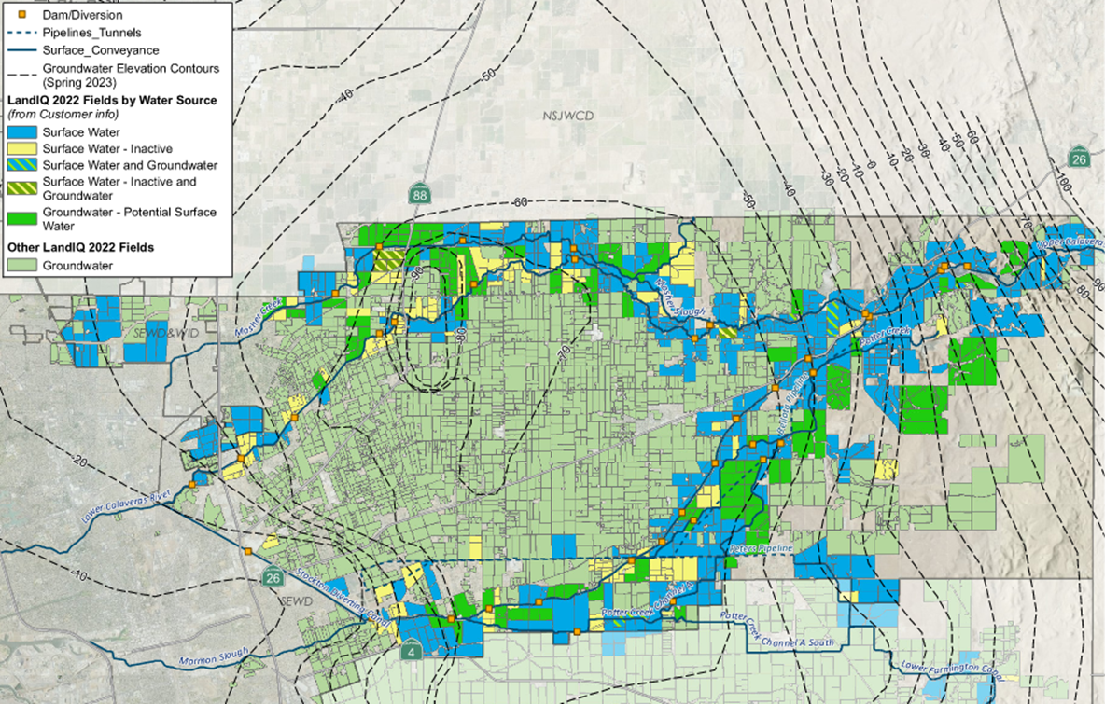


Slide 20
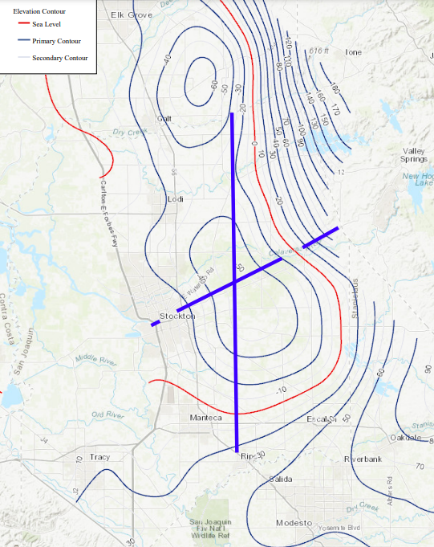
Current Groundwater Conditions
The cone of depression is located within our district in the area surrounding Linden.
North-South Cross Section
East-West Cross Section

Slide 21
Current Groundwater Conditions
East to West Section

Slide 22
Current Groundwater Conditions
North to South Section

Slide 23
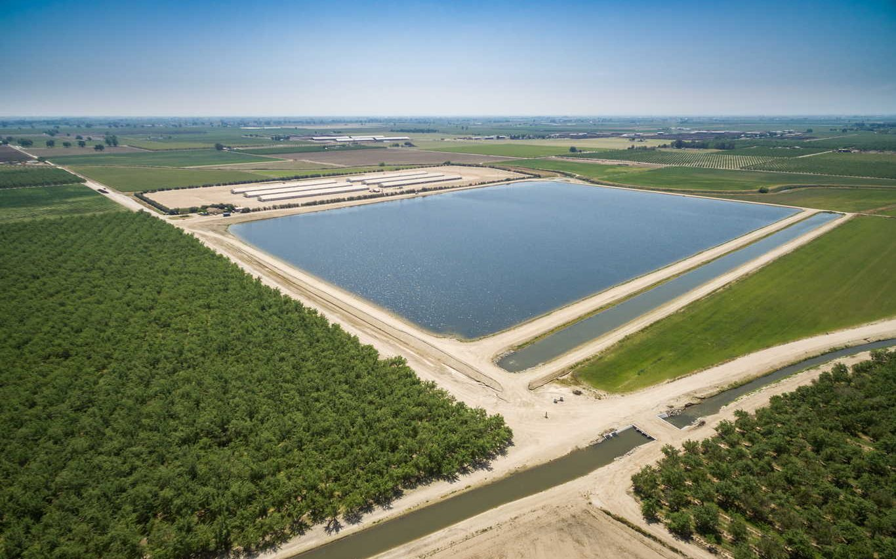
District Efforts to Reduce the Groundwater Deficit
Surface Water
Implementation and Expansion
Farmington Dam
West Groundwater
Recharge Basin
Water Supply Enhancement Project

Slide 24
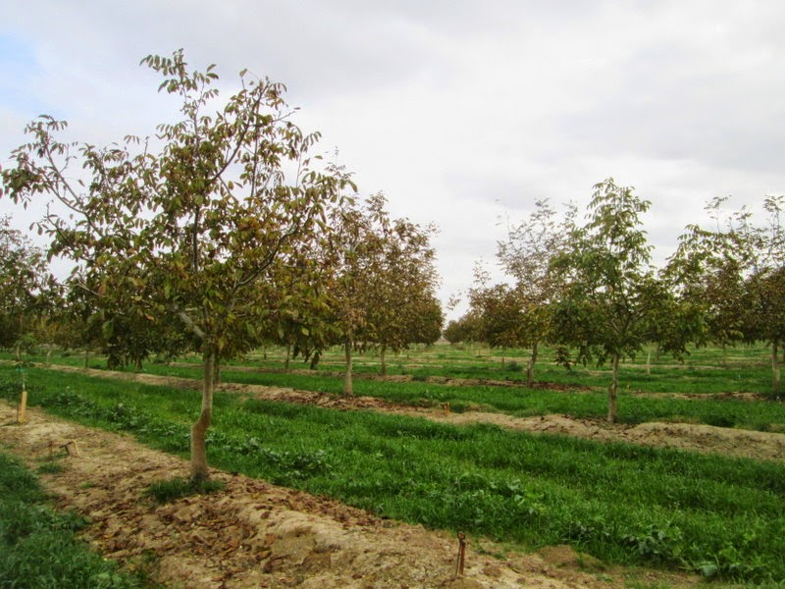
District Efforts with the Help of the Growers
Surface Water Implementation and Expansion Project
  Groundwater use to Surface Water use
  Current conversion by SEWD – 12,320 AF
  Convert 20,000 AF of Groundwater use to Surface Water Use
  May need additional 7,500 AF
Water Supply Enhancement Project
  Houston Pipeline
  DeMartini Pipeline
  Clements Pipeline
  Mosher Pipeline
  West Linden Project
ThePhoto by PhotoAuthor is licensed under CCYYSA.

Slide 25
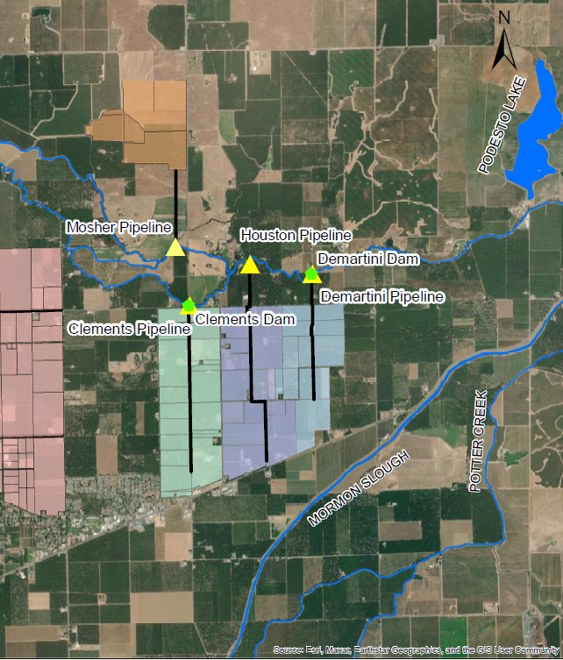

Water Supply Enhancement Project
Proposed Pipelines
  Houston Pipeline
  DeMartini Pipeline
  Clements Pipeline
  Mosher Pipeline

Slide 26
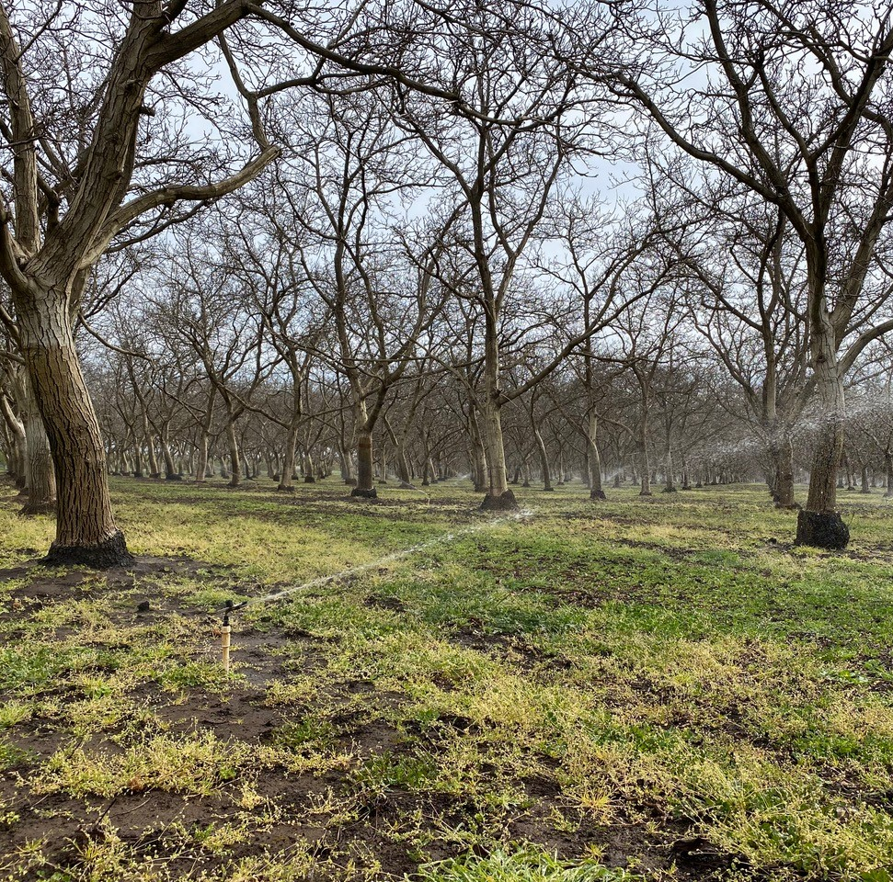
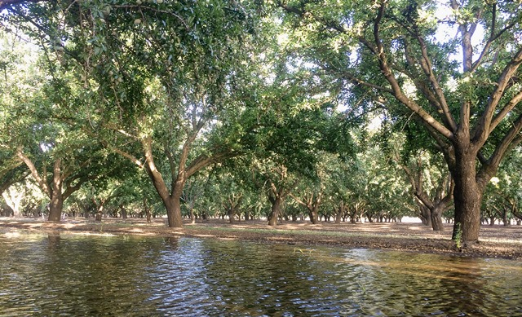
Improve on-farm irrigation efficiencies to save water.
Implement infrastructure to use Surface Water.
Only use groundwater when surface water is not available.
Participate in Flood-MAR.
How can you help?

Slide 27

Funding Opportunities
State Water and Energy Efficiency Program - Administered by the District (SWEEP BLOCK Grant)
Family Water Alliance
Potential Regional Conservation Partnership Program (RCPP) Funding through the District and NRCS

Slide 28
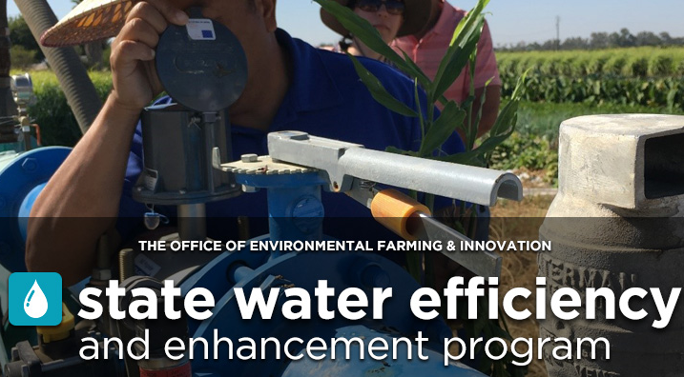

SWEEP Block Grant Round 1 Update
Thirteen projects have been selected for award.
In the first round $1.80 million in CDFA funds will be used to improve groundwater sustainability, reduce CO2 emissions, and conserve energy and water at the on-farm level.
The selected projects include installing surface water pumps, solar energy, soil moisture sensors, weather stations, VFDs, and flowmeters.

Slide 29

SWEEP Eligible Projects
Any project that involves water and energy savings. Examples of eligible projects include but are not limited to the following:
Converting from a groundwater source to surface water.
Installing a variable frequency drive.
Irrigation system improvements, such as, changing from flood irrigation to a micro sprinkler system.
Installing soil moisture sensors, flowmeter, ET sensors, weather station, telemetry, etc.
Changing crop type.
Utilizing a renewable energy source.

Slide 30
Family Water Alliance Program Grant
Since 1996, Family Water Alliance (FWA) has been the program manager in cooperation with state and federal agencies, and private contributors, in spearheading research, development and installation of fish screens on small agricultural diversions.
Funding sources are Prop 1 and United States Bureau of Reclamation
Application can be found in SEWD’s website: www.sewd.net/fish-screen-grant

Slide 31
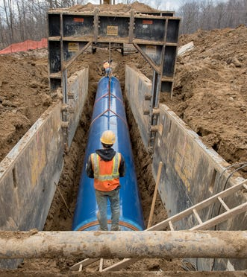
NRCS - RCPP Funding
The District requested $5,000,000 in funding to continue providing funding for growers to implement infrastructure to access surface water.
The District requested $14.2 million to potentially install three distribution pipelines off the Calaveras River to provide surface water to growers.

Slide 32
District Programs
Rule 159 – Surface Water Incentive Policy
Rule 176 – Securing Right-of-Way for District Interests Policy
Rule 177 – On-Farm Recharge of Surface Water Policy
Customer Access to Water Use Information

Slide 33
District Programs –
Surface Water Incentive Policy
Recover upfront capital costs for surface water diversion facilities through reduced surface water rate.
District supports planning, design, and permitting processes at no cost for indirect expenses (i.e. staff time).
Upon approval of Amortization Agreement, owner constructs improvements.
Surface water sold at groundwater rate until costs recovered or for seven (7) years, whichever occurs first.
Must commit to 15 years of surface water use or 10x groundwater rate.

Slide 34
District Programs –
Securing Right-of-Way for
District Interests Policy
District will support landowners’ efforts to access surface water, including lands not adjacent to waterways.
Coordinate introductions.
Facilitate meetings.
Provide guidance, support, feedback.
Secure right-of-way through available means if private negotiations fail.

Slide 35
District Programs –
On-Farm Recharge Policy
Earlier this year, the District approved a cost recovery program for growers that can recharge surface water between November 1st and April 30th.
Lifted Diversions – Landowners will receive payment of $80 per acre-foot of measured net recharge and a groundwater credit equal to 50% of the measured net recharged volume. For example, if 100 acre-feet are recharged, the landowner will receive compensation of $8,000 ($80/AF x 100AF) and a 50 acre-feet groundwater credit and the District will benefit by 50 acre-feet.
Gravity Diversions – Landowners will receive payment of $25 per acre-foot of measured net recharge and a groundwater credit equal to 50% of the measured net recharged volume. For example, if 100 acre-feet are recharged, the landowner will receive compensation of $2,500 ($25/AF x 100AF) and a 50 acre-feet groundwater credit and the District will benefit by 50 acre-feet.

Slide 36
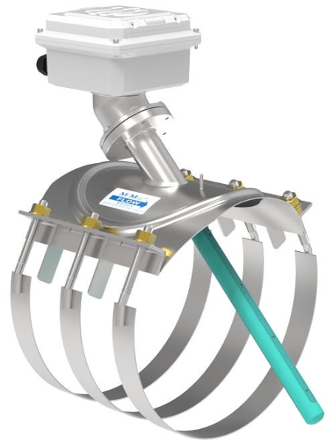
District Programs –
Access Water Use Information
For those that have a new McCrometer meter installed, it is connected to EyeOnWater, a cellular remote access website.
If you are interested, we have handouts with directions on how to access your meter readings.
You will need a cell phone with data or a computer connected to the internet.
Your account number is your associated parcel number.

Slide 37
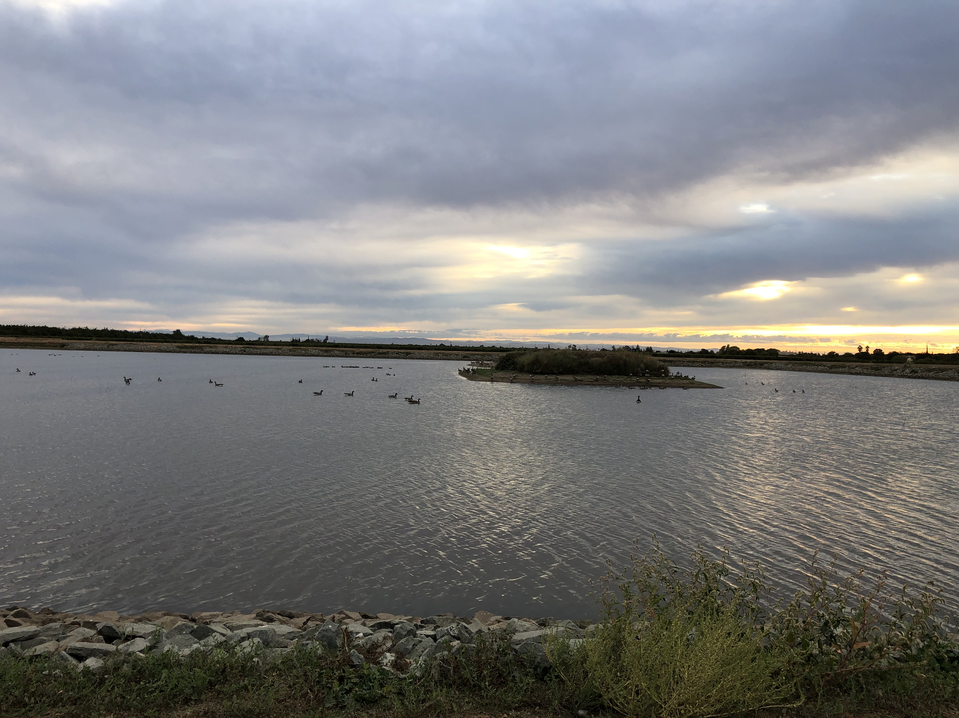
Key Take-Aways
Water Supplies are Uncertain
We have a Vision
SEWD is Taking Action
  Reliable Water Provider
  SGMA Leader
  Preservation of Supply
SGMA – In it Together
ThePhoto by PhotoAuthor is licensed under CCYYSA.

Slide 38
Customer Feedback
What can we do better?
How can we provide better service?
Concerned about capital improvement costs?
Concerned about Phytothora?
What do you want to hear about in the next grower meeting?
Link to 2023 UC Davis Phytothera Report
www.sewd.net/phytophthora-study
ThePhoto by PhotoAuthor is licensed under CCYYSA.

Slide 39
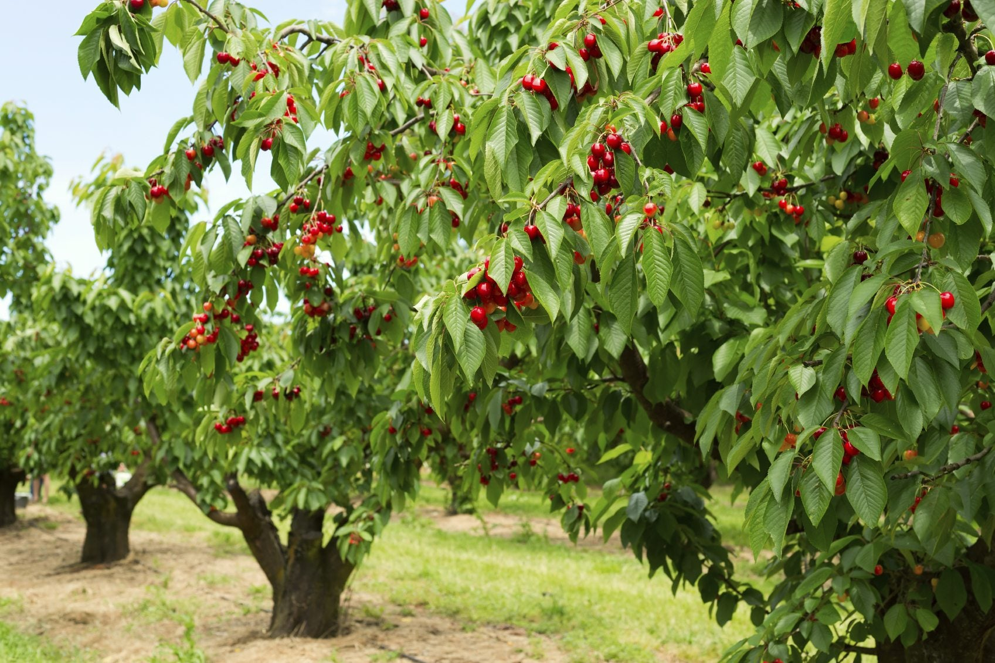
Thank You For Joining Us!
ThePhoto by PhotoAuthor is licensed under CCYYSA.

Slide 40
